Slide 1


搜集 · 评估 · 分析 · 决策
Profiling the Pulse of Scientific Fronts
SpellAtlas: Uncharted fingerprints of human misspelling behavior
胡智文 | 博士 & 教授
计算机科学与技术学院 | 计算社会科学协同创新中心
手机：13676458899
邮箱：huzhiwen@zjgsu.edu.cn
网址：http://zhiwenhu.hustoj.com/
地址：中国 · 浙江 · 杭州
下沙高教园区学正街18号信息楼332室

Slide 2
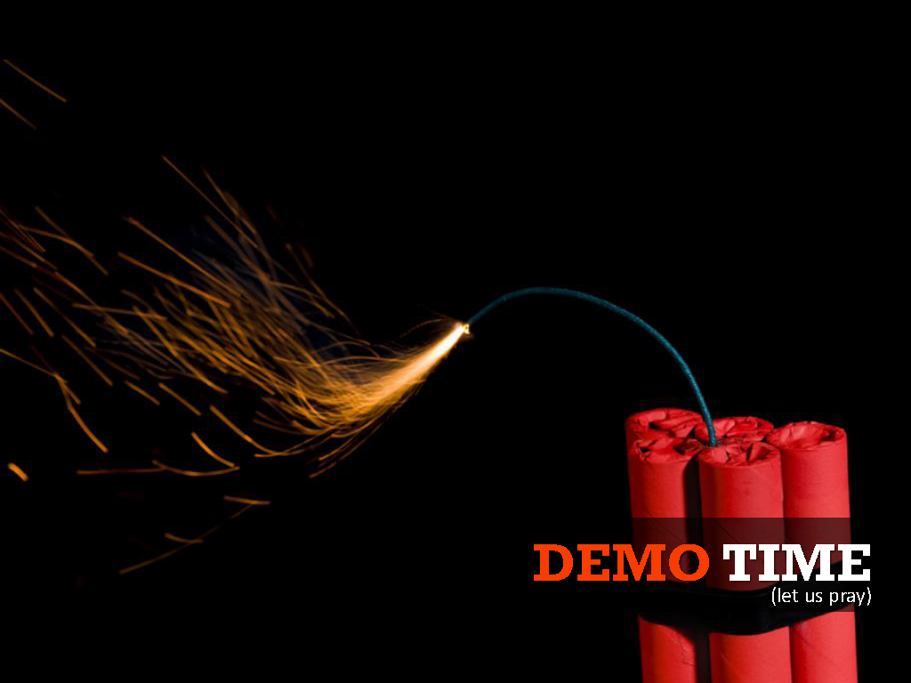
『基准原生诱陷与LLM认知过载』

Slide 3

Goodhart’s Law
“When a measure becomes a target, it ceases to be a good measure.”
Goodhart's law. https://en.wikipedia.org/wiki/Goodhart%27s_law

Slide 4
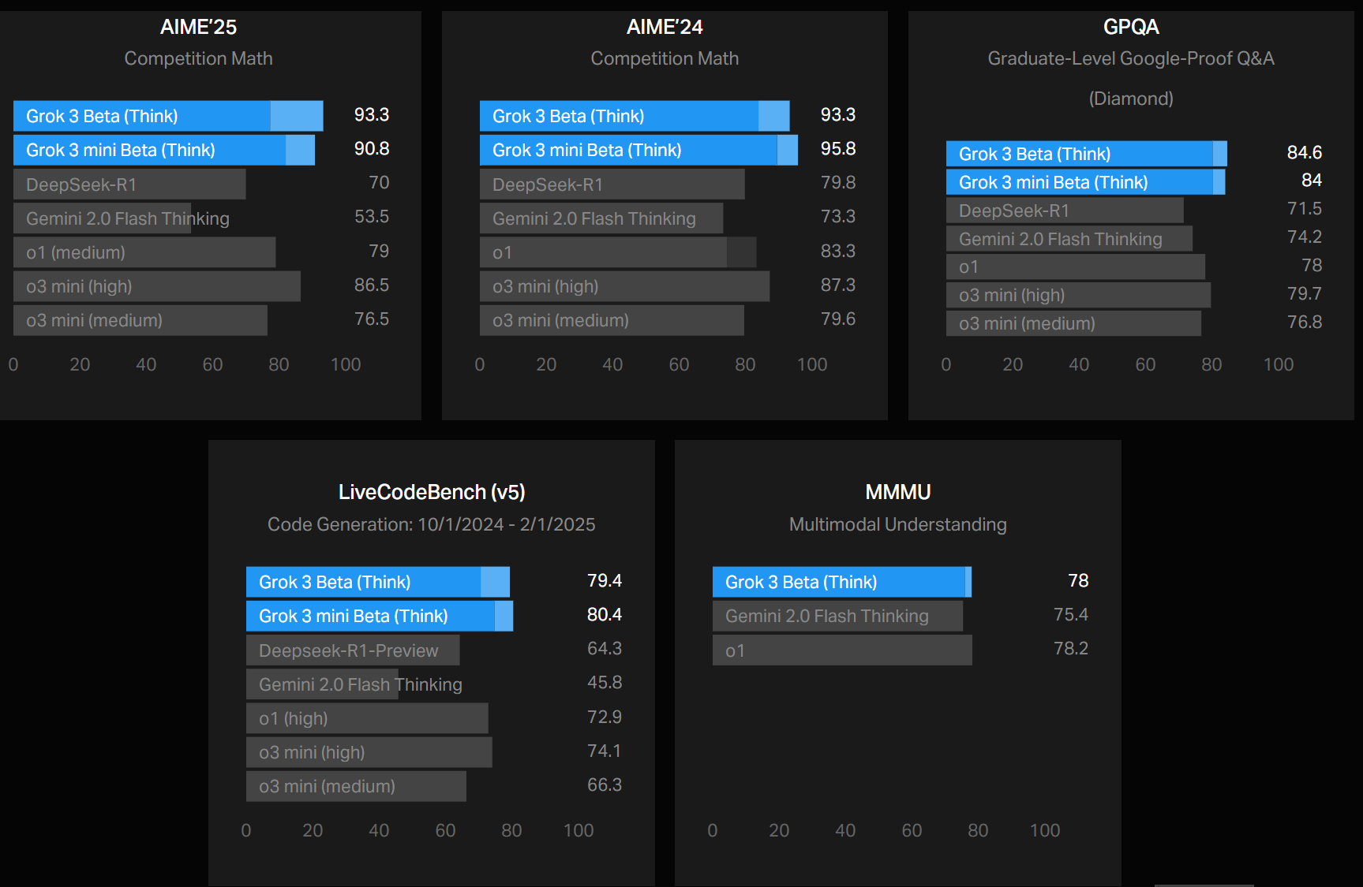

LLM基准:
Goodhart’s Law
LLM Leaderboard可信嘛？
Strathern, M. ‘Improving ratings’: audit in the British University system. Eur. Rev. 5, 305–321 (1997)(Goodhart’s Law). | Guo, D. et al. DeepSeek-R1 incentivizes reasoning in LLMs through reinforcement learning. Nature 645, 633–638 (2025).

Slide 5
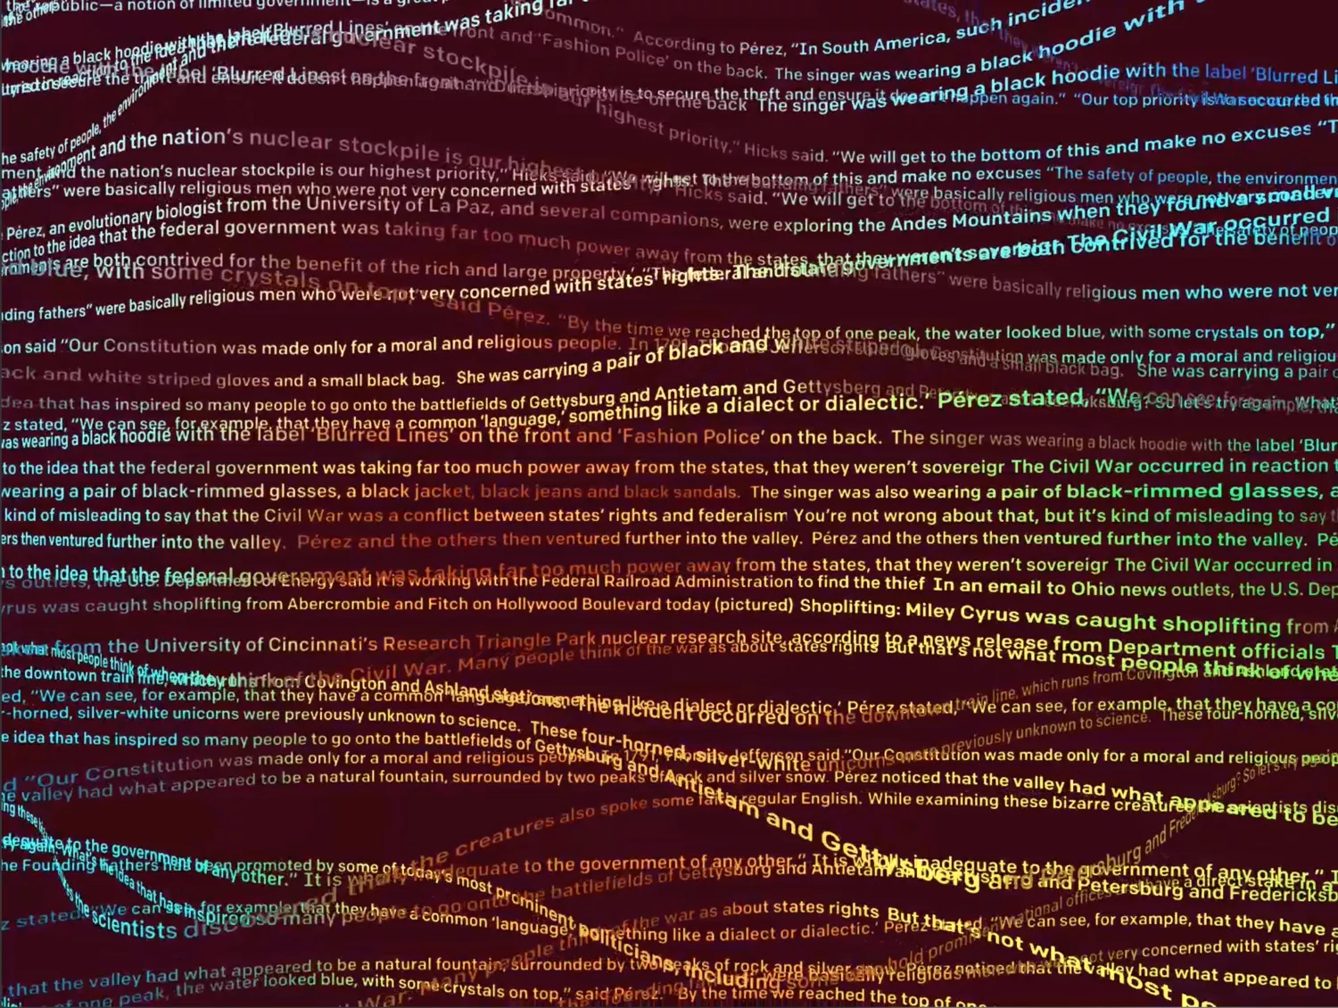
Intra-Benchmark Attack(IBA)
Strathern, M. ‘Improving ratings’: audit in the British University system. Eur. Rev. 5, 305–321 (1997)(Goodhart’s Law). | Khoury, M. J. & Ioannidis, J. P. A. Big data meets public health. Science 346, 1054–1055 (2014). | Landau, S. Control use of data to protect privacy. Science 347, 504–506 (2015). | Battiston, S. et al. Complexity theory and financial regulation. Science 351, 818–819 (2016). | Arani, B. M. S., et al. Exit time as a measure of ecological resilience. Science 372, (2021). | Cornwall, W. Unleashing big muddy. Science 372, 334–337 (2021).

Slide 6
基准原生诱陷与LLM认知过载
基准原生诱陷(Benchmark Native Entrapment, BNE)
在LLM基准数据集生命周期中，由于人为或系统性因素引入的结构化、重复性或高可预测模式，诱导模型在训练、推理与对齐过程中将这些模式误识别为高因果强度特征，并持续主导决策路径，最终在真实任务中出现系统性失效。
LLM认知过载(Cognitive Overload)：BNE驯化在潜在空间/注意力/泛化层面的系统性失能表现
内部表征污染（Latent Representation Poisoning）
诱陷模式在训练集/评估集中高频共现
在 embedding/hidden state 中形成异常紧密的向量聚类
概念边界发生塌缩（concept collapse）
注意力机制失焦（Attention Hijacking）
注意力预算被非因果但强模式特征劫持
真正需要组合推理的 token 得不到足够权重
泛化能力锚定（Generalization Anchoring）
诱陷特征 → 正确输出
诱陷特征缺失或变化 → 模型策略崩溃
Strathern, M. ‘Improving ratings’: audit in the British University system. Eur. Rev. 5, 305–321 (1997)(Goodhart’s Law). | The Unicode Consortium. The Unicode Standard, Version 17.0.0, (South San Francisco: The Unicode Consortium, 2025. https://www.unicode.org/versions/Unicode17.0.0/

Slide 7
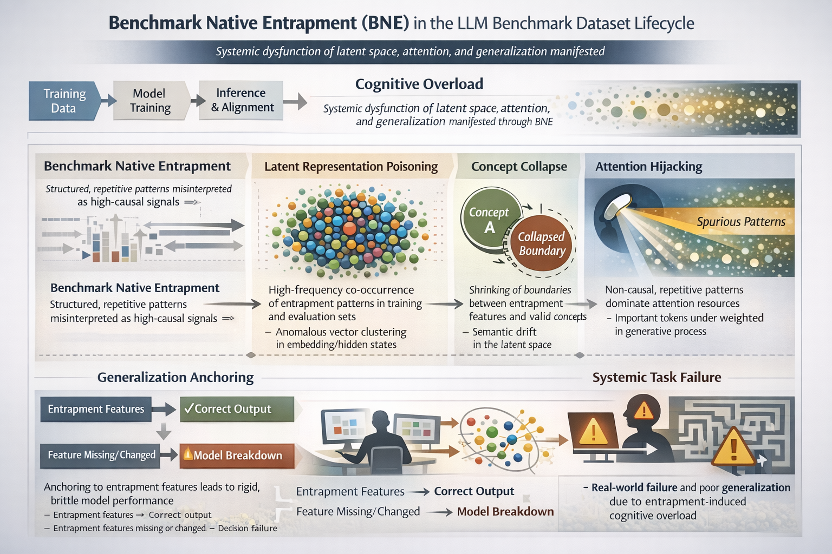

Slide 8

Holistic Perturbation Assessment Framework (HPAF)

Slide 9
基准原生诱陷: 原生性+系统性+诱导性
The 25 Unicode White_Space code points, names and rationales
Code Point | Character Name | Rationale
U+0009 | CHARACTER TABULATION | Horizontal spacing, advances to next tab stop
U+000A | LINE FEED (LF) | Primary line terminator (Unix)
U+000B | LINE TABULATION (VT) | Vertical spacing control
U+000C | FORM FEED (FF) | Page/Form break control
U+000D | CARRIAGE RETURN (CR) | Part of CRLF sequence
U+0020 | SPACE | Default word separator
U+0085 | NEXT LINE (NEL) | Single-character line terminator
U+00A0 | NO-BREAK SPACE (NBSP) | Prevents line breaks
U+1680 | OGHAM SPACE MARK | Used in Ogham script
U+2000 | EN QUAD | Typographic spacing (1/2 em wide)
U+2001 | EN QUAD | Typographic spacing (Full em wide)
U+2002 | EN SPACE | Typographic spacing (1/2 em wide)
U+2003 | EM SPACE | Typographic spacing (Full em wide)
U+2004 | THREE-PER-EM SPACE | Typographic spacing (1/3 em wide)
U+2005 | FOUR-PER-EM SPACE | Typographic spacing (1/4 em wide)
U+2006 | SIX-PER-EM SPACE | Typographic spacing (1/6 em wide)
U+2007 | FIGURE SPACE | Width equal to a standard digit
U+2008 | PUNCTUATION SPACE | Width equal to a narrow punctuation mark
U+2009 | THIN SPACE | Small separation, recommended for SI units
U+200A | HAIR SPACE | Thinnest visible space
U+2028 | LINE SEPARATOR (LSEP) | Line break effector
U+2029 | PARAGRAPH SEPARATOR (PS) | Mandatory paragraph break
U+202F | NARROW NO-BREAK SPACE | Narrower non-breaking space
U+205F | MEDIUM MATHEMATICAL SPACE | Used for mathematical formulae
U+3000 | IDEOGRAPHIC SPACE | Width equal to a CJK character cell
Strathern, M. ‘Improving ratings’: audit in the British University system. Eur. Rev. 5, 305–321 (1997)(Goodhart’s Law). | The Unicode Consortium. The Unicode Standard, Version 17.0.0, (South San Francisco: The Unicode Consortium, 2025. https://www.unicode.org/versions/Unicode17.0.0/

Slide 10
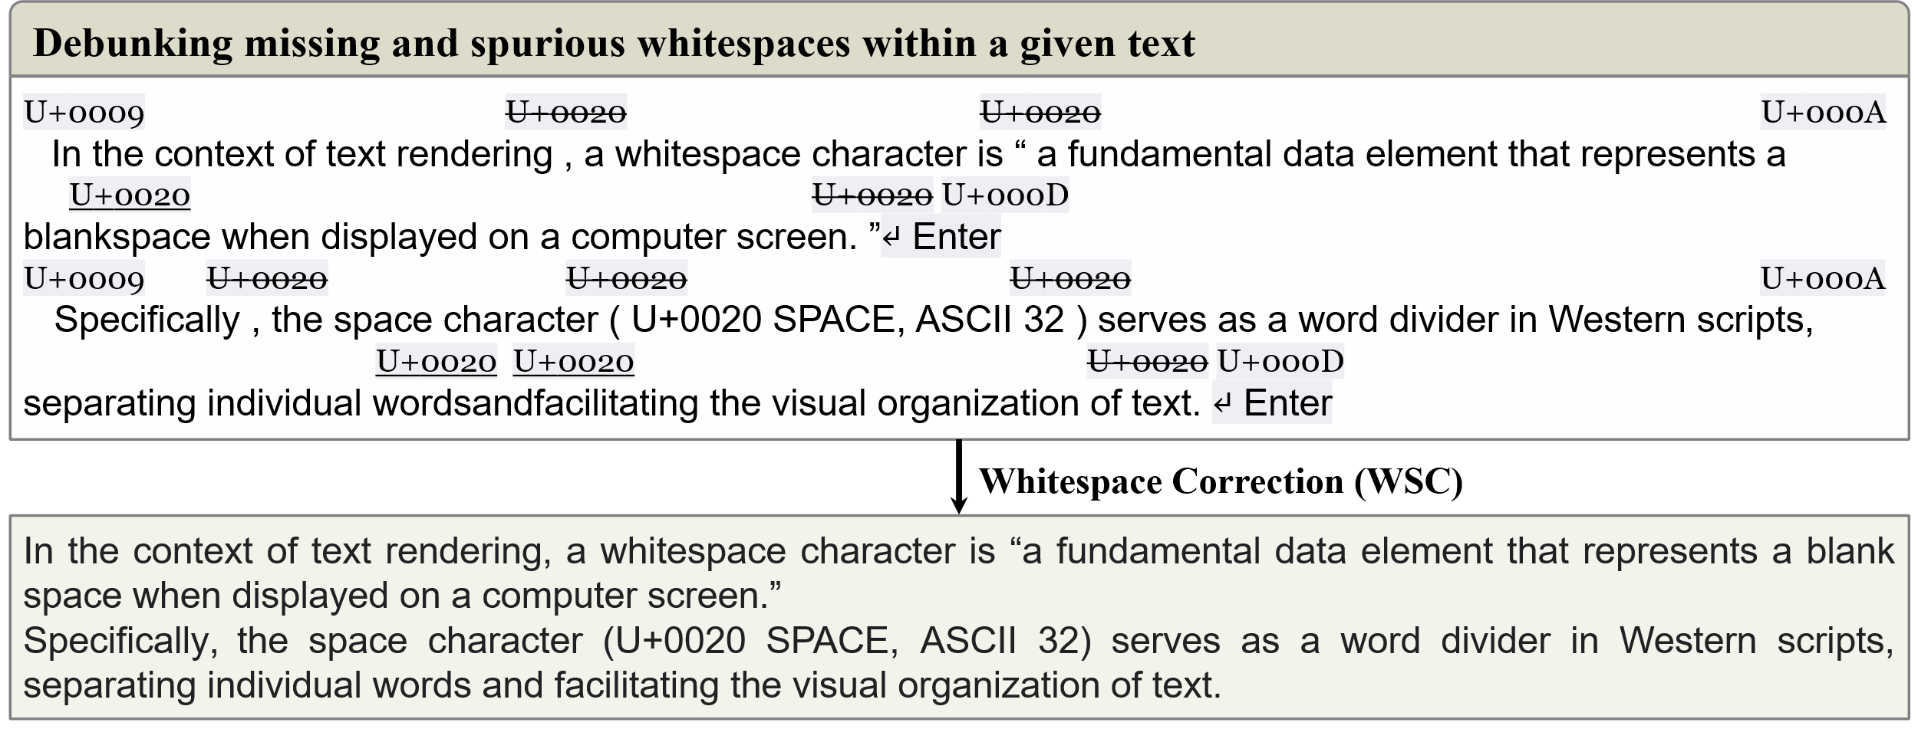
基准原生诱陷: 原生性+系统性+诱导性
The Whitespace Correction (WSC) task is a text processing operation that involves the detection and correction of covert missing and spurious whitespaces in a given text, with the goal of maintaining a conventional contextual layout and adhering to the Unicode standard.
ˆ The schema of whitespace correction task. The WSC task involves a two-step approach: debunking whitespace errors and correcting whitespace errors.
Bast, H., Hertel, M. & Walter, S. Fast whitespace correction with encoder-only Transformers. Proceedings of the 61st Annual Meeting of the Association for Computational Linguistics 389–399 (Association for Computational Linguistics, 2023). doi:10.18653/v1/2023.acl-demo.37. | Robyn Speer. (2019). ftfy (Version 5.5). Zenodo. http://doi.org/10.5281/zenodo.2591652

Slide 11
基准原生诱陷: 原生性+系统性+诱导性
The Achilles’ heel
Theoretical implications: The over-correction conundrum highlights the importance of striking a balance between text correction and preservation of contextual information. Theoretical models, such as the noisy channel model, can be employed to mitigate the effects of over-correction and ensure that the cleaned text remains faithful to its original intent.
Whitespace correction (WSC): A perplexity-sensitive task
PPL=10.6843
Whitespace characters are fundamental data elements, serving as word dividers in Western scripts, separating individual words and facilitating the visual organization of text rendering.
PPL=10.1326
Whitespace characters are fundamental data elements, serving as word dividers in Western scripts, separating individual words and facilitating the visual organization of text rendering.
ˆ Comparative perplexities of text before and after whitespace correction (WSC). Although the original and cleaned texts differ by merely a single leading whitespace, the annotated tokens reveal a subtle transformation in tokenization, highlighting its impact on subsequent text representation.
Bast, H., Hertel, M. & Walter, S. Fast whitespace correction with encoder-only Transformers. Proceedings of the 61st Annual Meeting of the Association for Computational Linguistics 389–399 (Association for Computational Linguistics, 2023). doi:10.18653/v1/2023.acl-demo.37. | Robyn Speer. (2019). ftfy (Version 5.5). Zenodo. http://doi.org/10.5281/zenodo.2591652

Slide 12
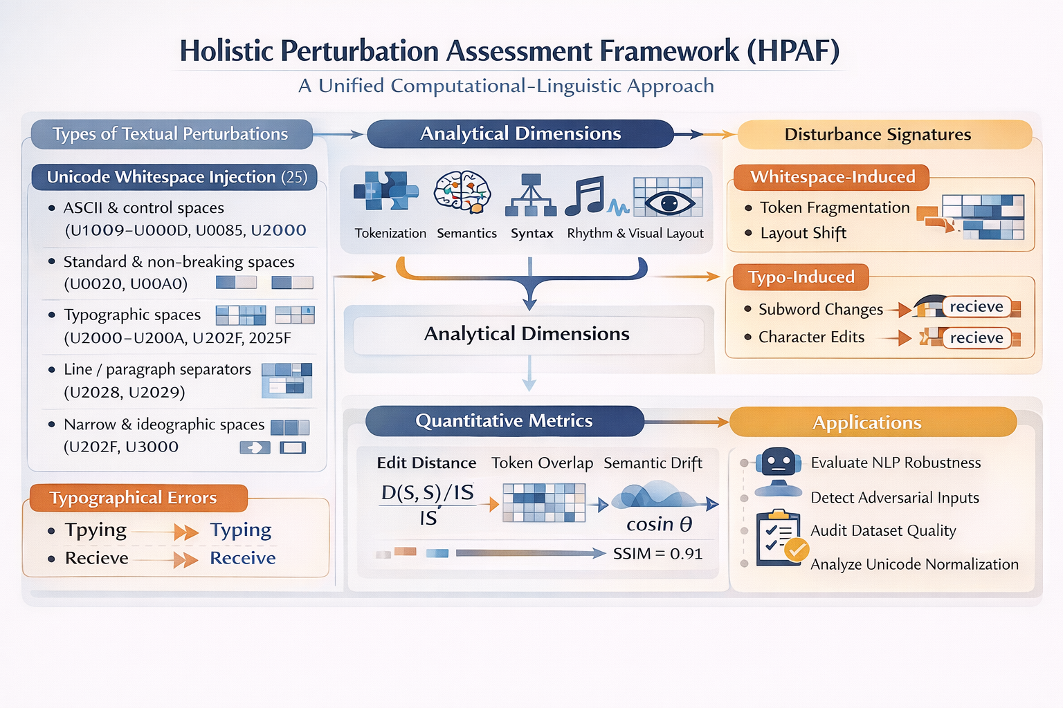

Slide 13
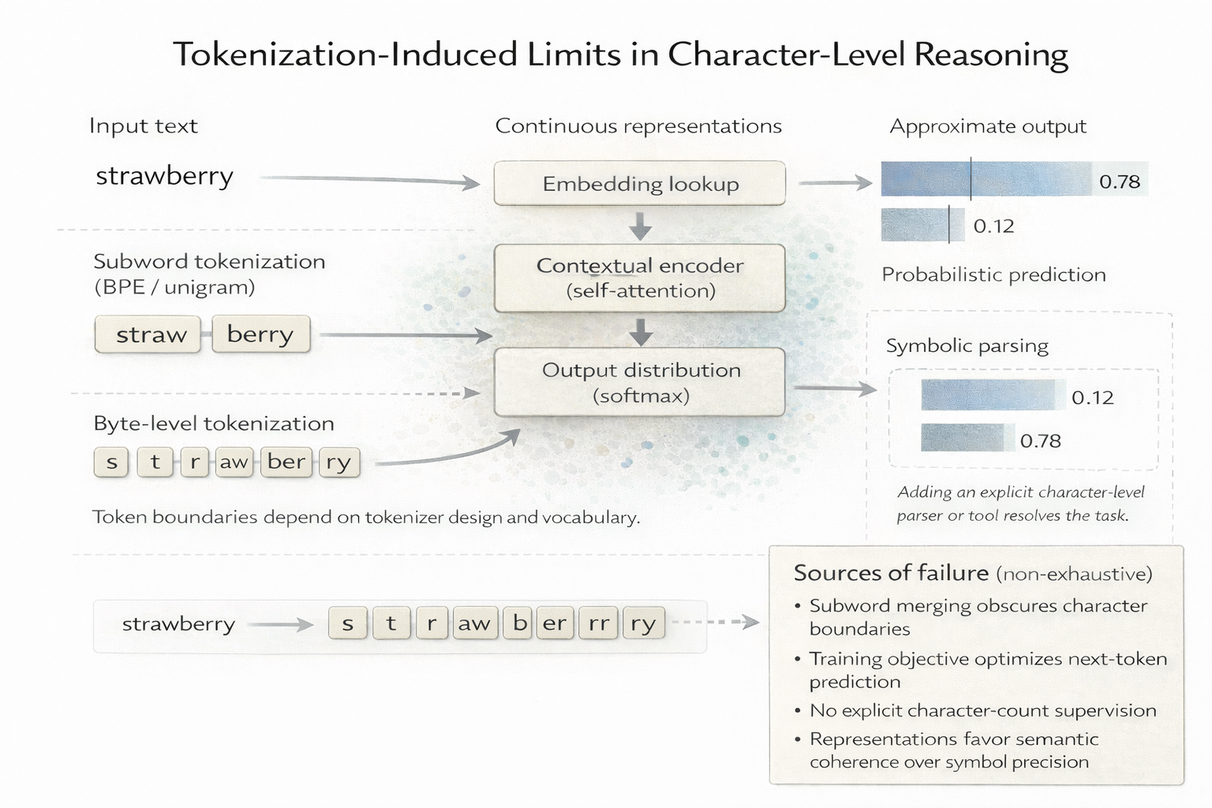
ˆ The Strawberry Problem. The “strawberry problem” in large language models refers to the systematic difficulty models exhibit in performing fine-grained character-level reasoning—such as accurately counting letter occurrences within a word—despite demonstrating strong high-level linguistic fluency. For example, an LLM may fail to determine that the word “strawberry” contains three instances of the letter “r”. This phenomenon reflects a structural limitation of token-based architecture, in which discrete character information is compressed into subword or token representations optimized for semantic prediction rather than exact orthographic manipulation. The strawberry problem thus exposes a fundamental tension between semantic abstraction and symbolic precision in current LLMs.

Slide 14
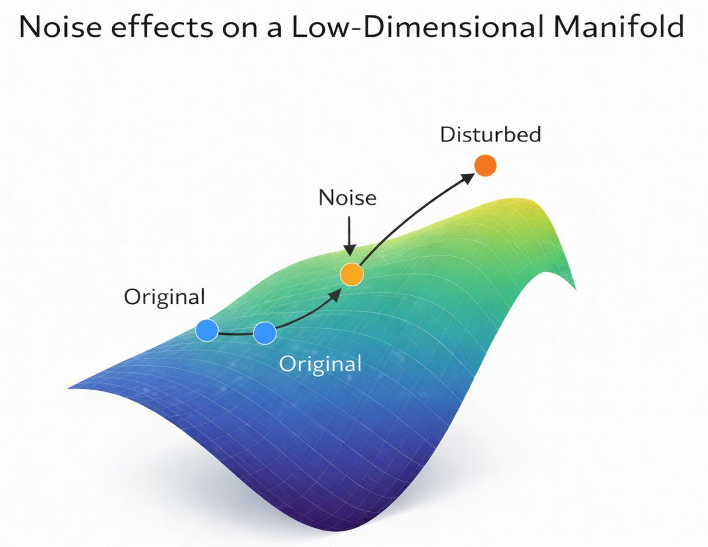
ˆ Effects of intrinsic noise on manifold-based reasoning. Conceptual schematic illustrating how noise inherent to data collection and curation reshapes the latent representational manifold and, in turn, influences reasoning. The manifold is defined by the statistical and semantic structure of the dataset, with unperturbed samples lying on it by construction. Noise (e.g., whitespace, typos) arising from incomplete data cleaning, annotation ambiguity, or spurious co-occurrences is modeled as an internal perturbation operator acting on representations during learning. These perturbations give rise to locally distorted representations that deform the manifold geometry, altering neighborhood relationships, continuity, and effective traversal paths in latent space. Such geometric distortions offer a mechanistic account of how dataset-intrinsic noise impacts reasoning, by modifying the underlying geometric substrate on which inference and compositional generalization implicitly operate.

Slide 15
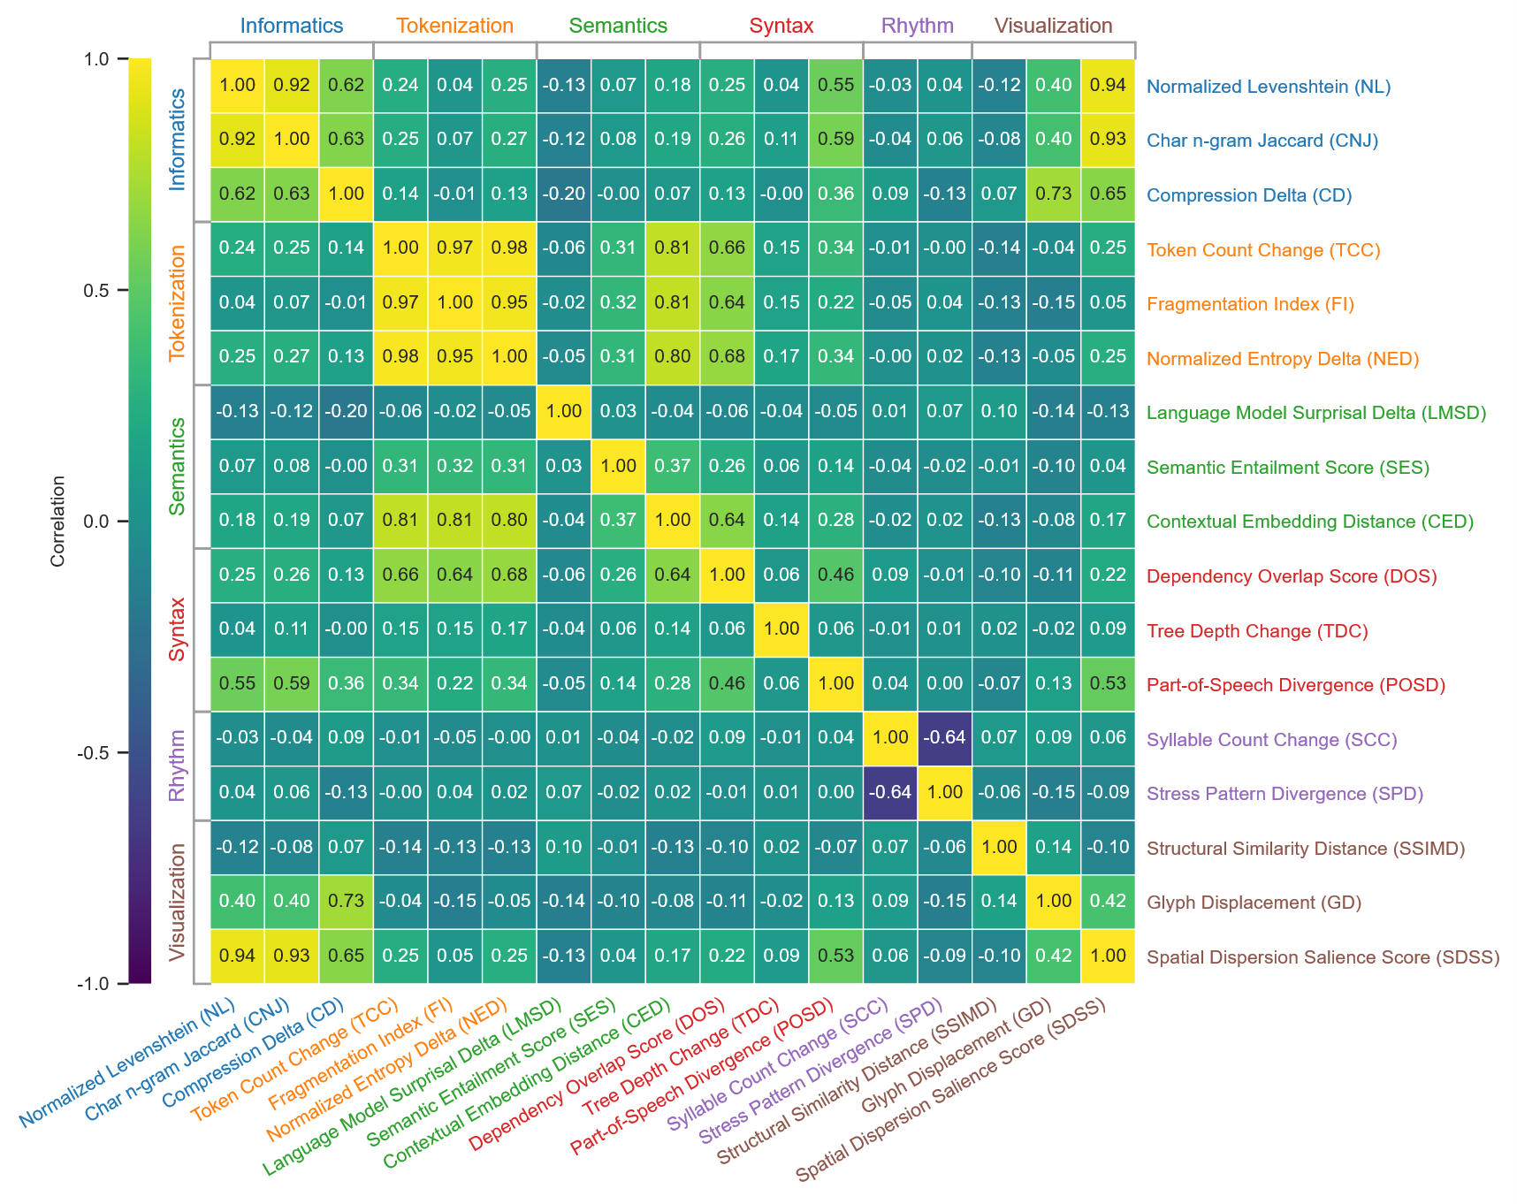
ˆ Metric taxonomy. This hierarchical metric taxonomy cluster map organizes 17 linguistic metrics into six theoretical dimensions (Informatics, Tokenization, Semantics, Syntax, Rhythm, and Visualization), displaying Pearson correlation coefficients ranging from -1.0 (purple, strong negative) to 1.0 (yellow, strong positive). Metrics are clustered hierarchically based on functional similarities, with row and column dendrograms revealing groupings derived from pairwise correlations. High positive correlations indicate metrics that co-vary robustly in response to text perturbations, while negative values suggest inverse relationships, and near-zero (teal) imply independence.

Slide 16
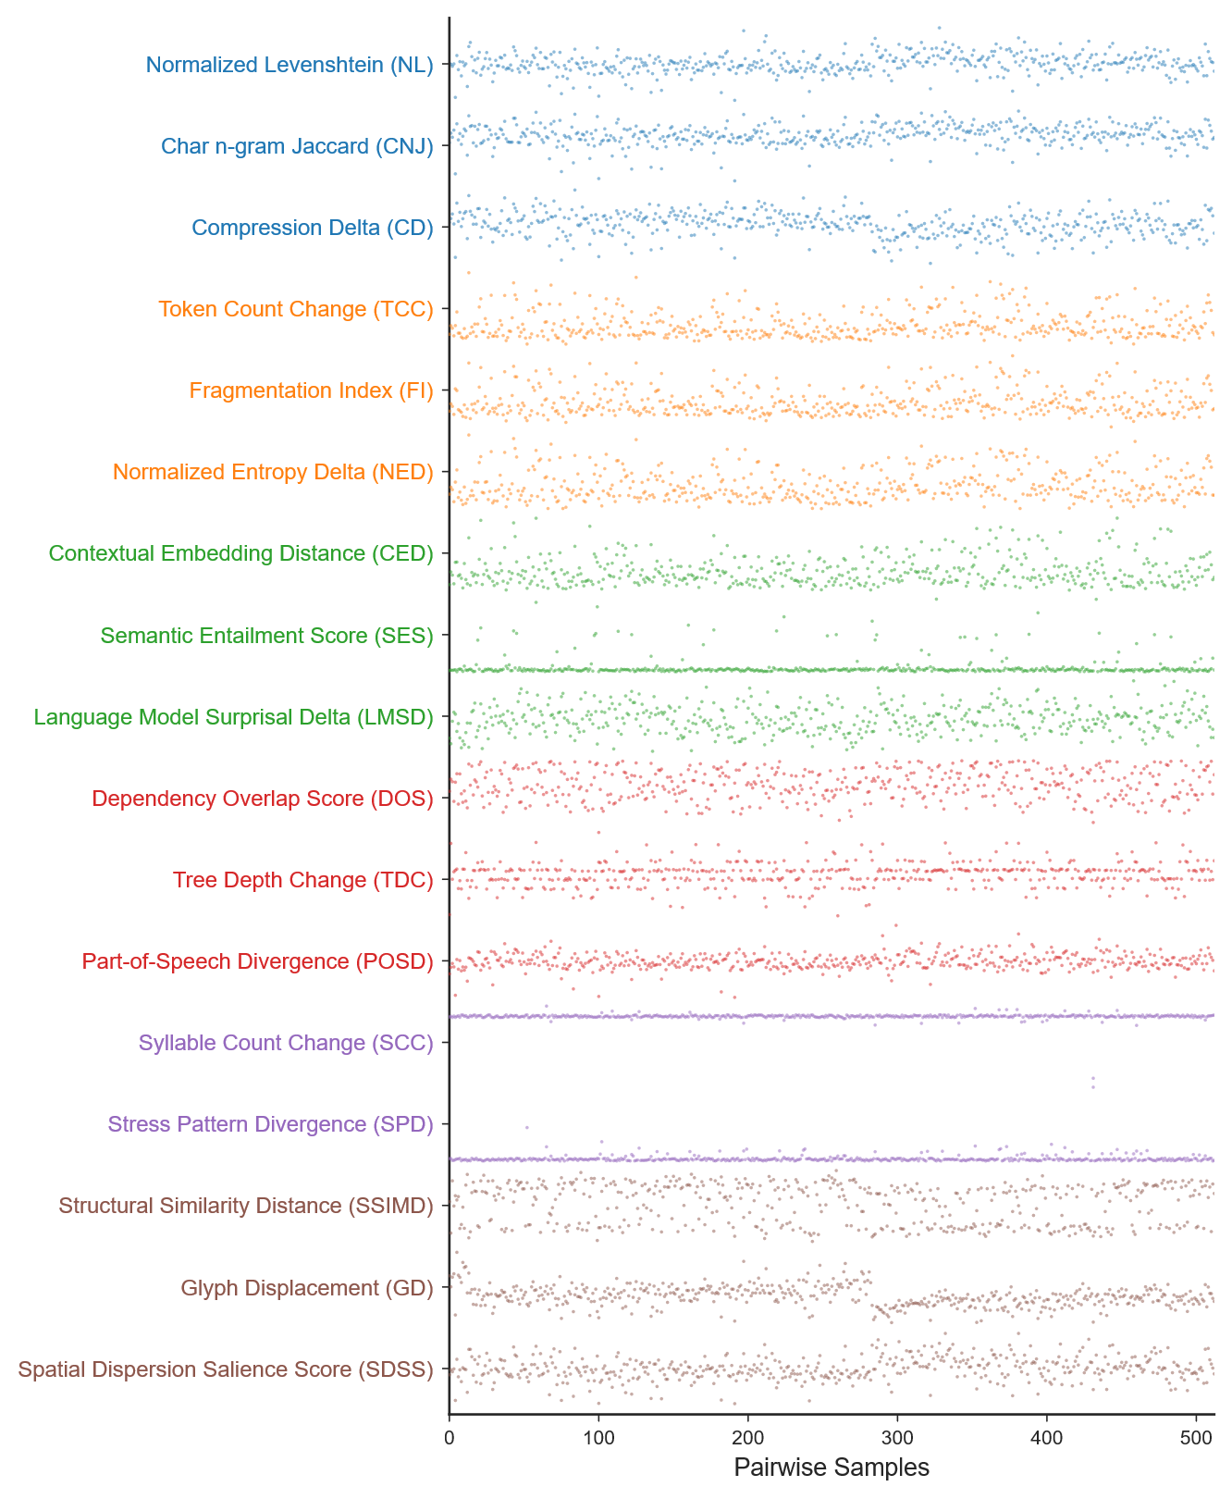
ˆ Metric taxonomy. This hierarchical metric taxonomy cluster map organizes 17 linguistic metrics into six theoretical dimensions (Informatics, Tokenization, Semantics, Syntax, Rhythm, and Visualization), displaying Pearson correlation coefficients ranging from -1.0 (purple, strong negative) to 1.0 (yellow, strong positive). Metrics are clustered hierarchically based on functional similarities, with row and column dendrograms revealing groupings derived from pairwise correlations. High positive correlations indicate metrics that co-vary robustly in response to text perturbations, while negative values suggest inverse relationships, and near-zero (teal) imply independence.

Slide 17
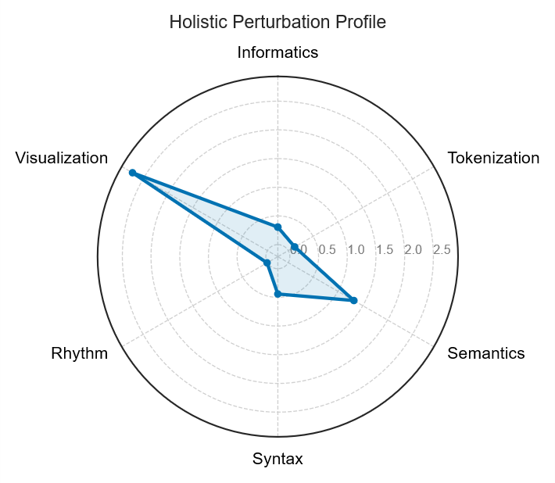
ˆ Distinct perturbation patterns across linguistic dimensions. This radar chart aggregates 17 normalized metrics clustered into six linguistic dimensions, illustrating the mean disturbance magnitude induced by text perturbations in a parallel corpus. The radial axis represents adaptively scaled values to emphasize micro-level changes, with metrics grouped by their sensitivity to functional aspects such as edit distances, subword fragmentation, embedding similarities, dependency parsing, prosodic variability, and glyph renderings. Data derived from comparative analysis of original and perturbed sentences, normalized against baseline similarities.

Slide 18
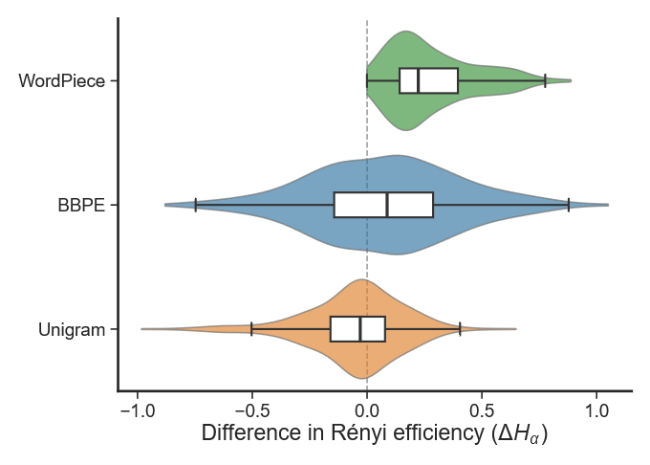
Table 1 Token distribution statistics
ˆ Token distribution statistics. Using our parallel corpus—paired original and disturbed texts—we measure tokenizer-induced distributional shifts under perturbation for three widely used algorithms: WordPiece, byte-level BPE (BBPE), and Unigram. We compute Rényi efficiency with 𝛼=2.5 on each side of the parallel pairs and report the efficiency delta as a direct index of robustness. The perturbation responses are clearly differentiated. Unigram is most sensitive, showing a small efficiency decrease (-0.0548), consistent with perturbation-driven fragmentation that increases rare-token mass and destabilizes distribution. BBPE is moderately affected (+0.0764), consistent with probabilistic subword selection that attenuates extreme rarity. WordPiece exhibits a small efficiency increase (+0.2807), suggesting morphology-aligned merging can absorb certain disturbances by yielding plausible subwords without substantially worsening imbalance.
Model | Tokenization Type | Rényi efficiency (α=2.5) |  | Delta
 |  | Original | Perturbed
bert-base-uncased | WordPiece | 2.4931 | 2.7738 | 0.2807
gpt2 | BBPE | 2.4776 | 2.5540 | 0.0764
t5-base | Unigram | 2.5511 | 2.4963 | -0.0548

Slide 19
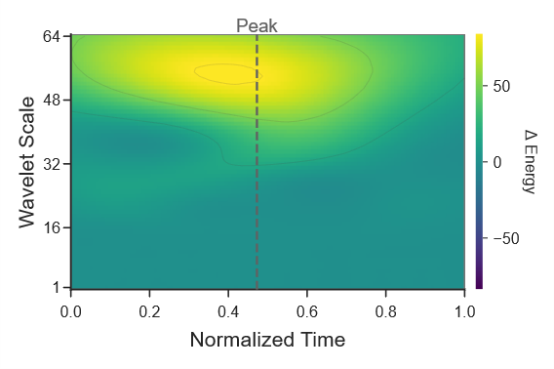
ˆ Noise effects in text embeddings. This scalogram depicts the differential energy derived from the continuous wavelet transform (CWT) of principal component analysis (PCA)-reduced sentence embeddings, comparing perturbed and original versions. The workflow is: sentence embeddings → PCA → CWT using complex Morlet wavelet with scales ranging from 1 to 64 and time resolution Δt = 1 token → energy E = |W|² → ΔE = E_{perturbed} - E_{original}. The x-axis shows normalized time τ (corresponding to token positions), and the y-axis represents wavelet scale s (inversely proportional to frequency). Colors are mapped using robust percentile limits by default, with yellow indicating positive differences (higher energy in perturbed signals) and blue negative.

Slide 20
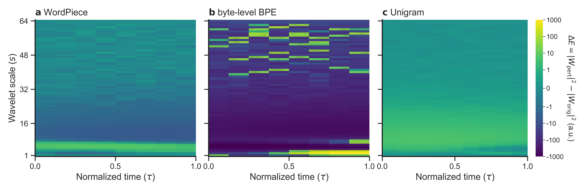
ˆ Noise effects in text embeddings. This scalogram depicts the differential energy derived from the continuous wavelet transform (CWT) of principal component analysis (PCA)-reduced sentence embeddings, comparing perturbed and original versions. The workflow is: sentence embeddings → PCA → CWT using complex Morlet wavelet with scales ranging from 1 to 64 and time resolution Δt = 1 token → energy E = |W|² → ΔE = E_{perturbed} - E_{original}. The x-axis shows normalized time τ (corresponding to token positions), and the y-axis represents wavelet scale s (inversely proportional to frequency). Colors are mapped using robust percentile limits by default, with yellow indicating positive differences (higher energy in perturbed signals) and blue negative.

Slide 21
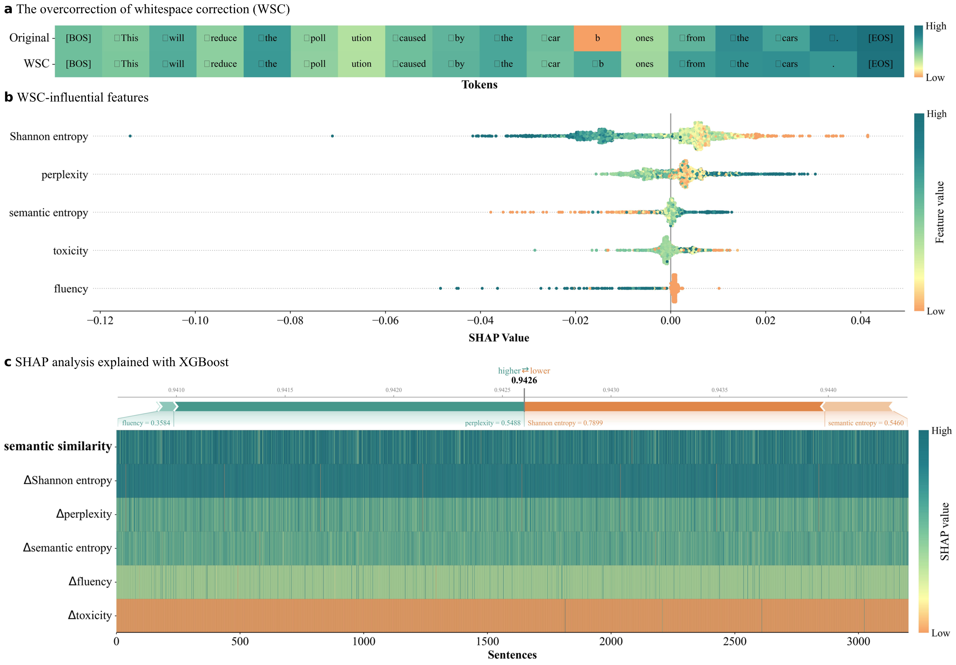

Slide 22
A single-whitespace rewards jailbreak for LLMs

Slide 23
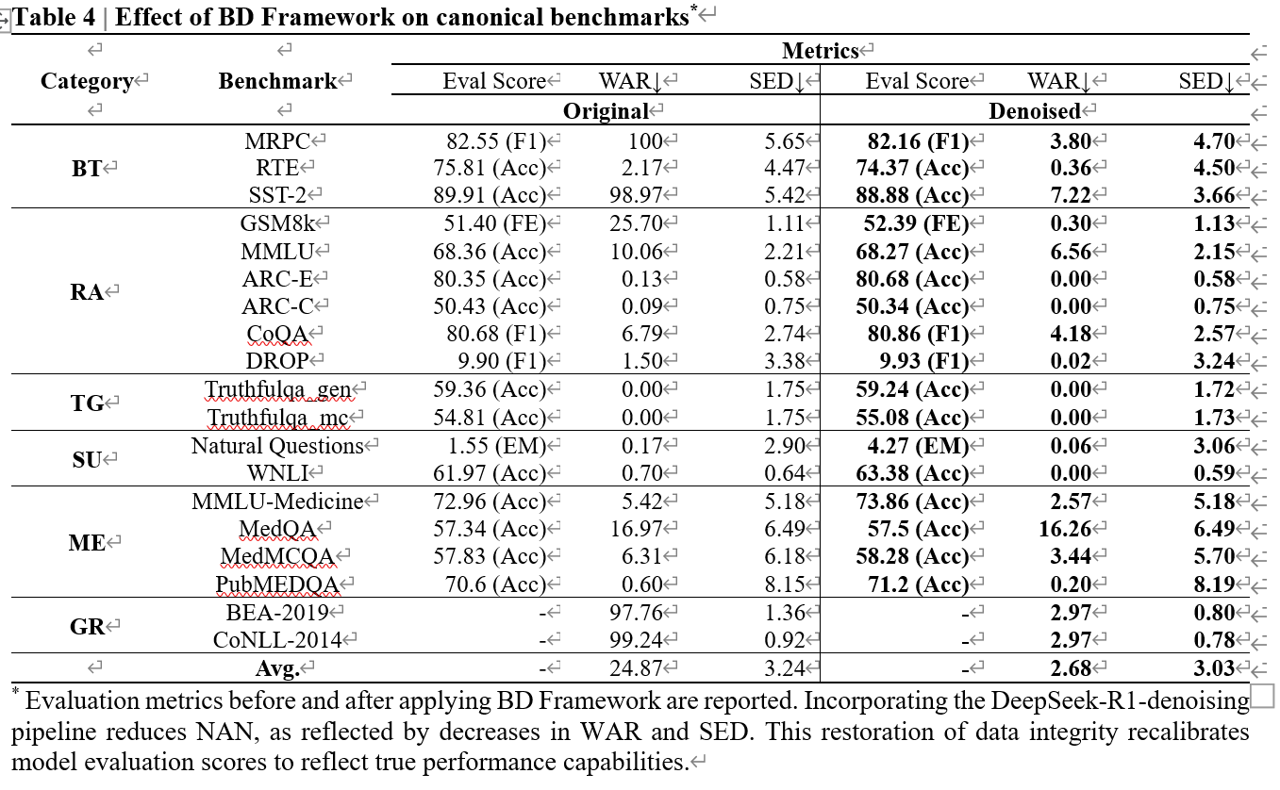
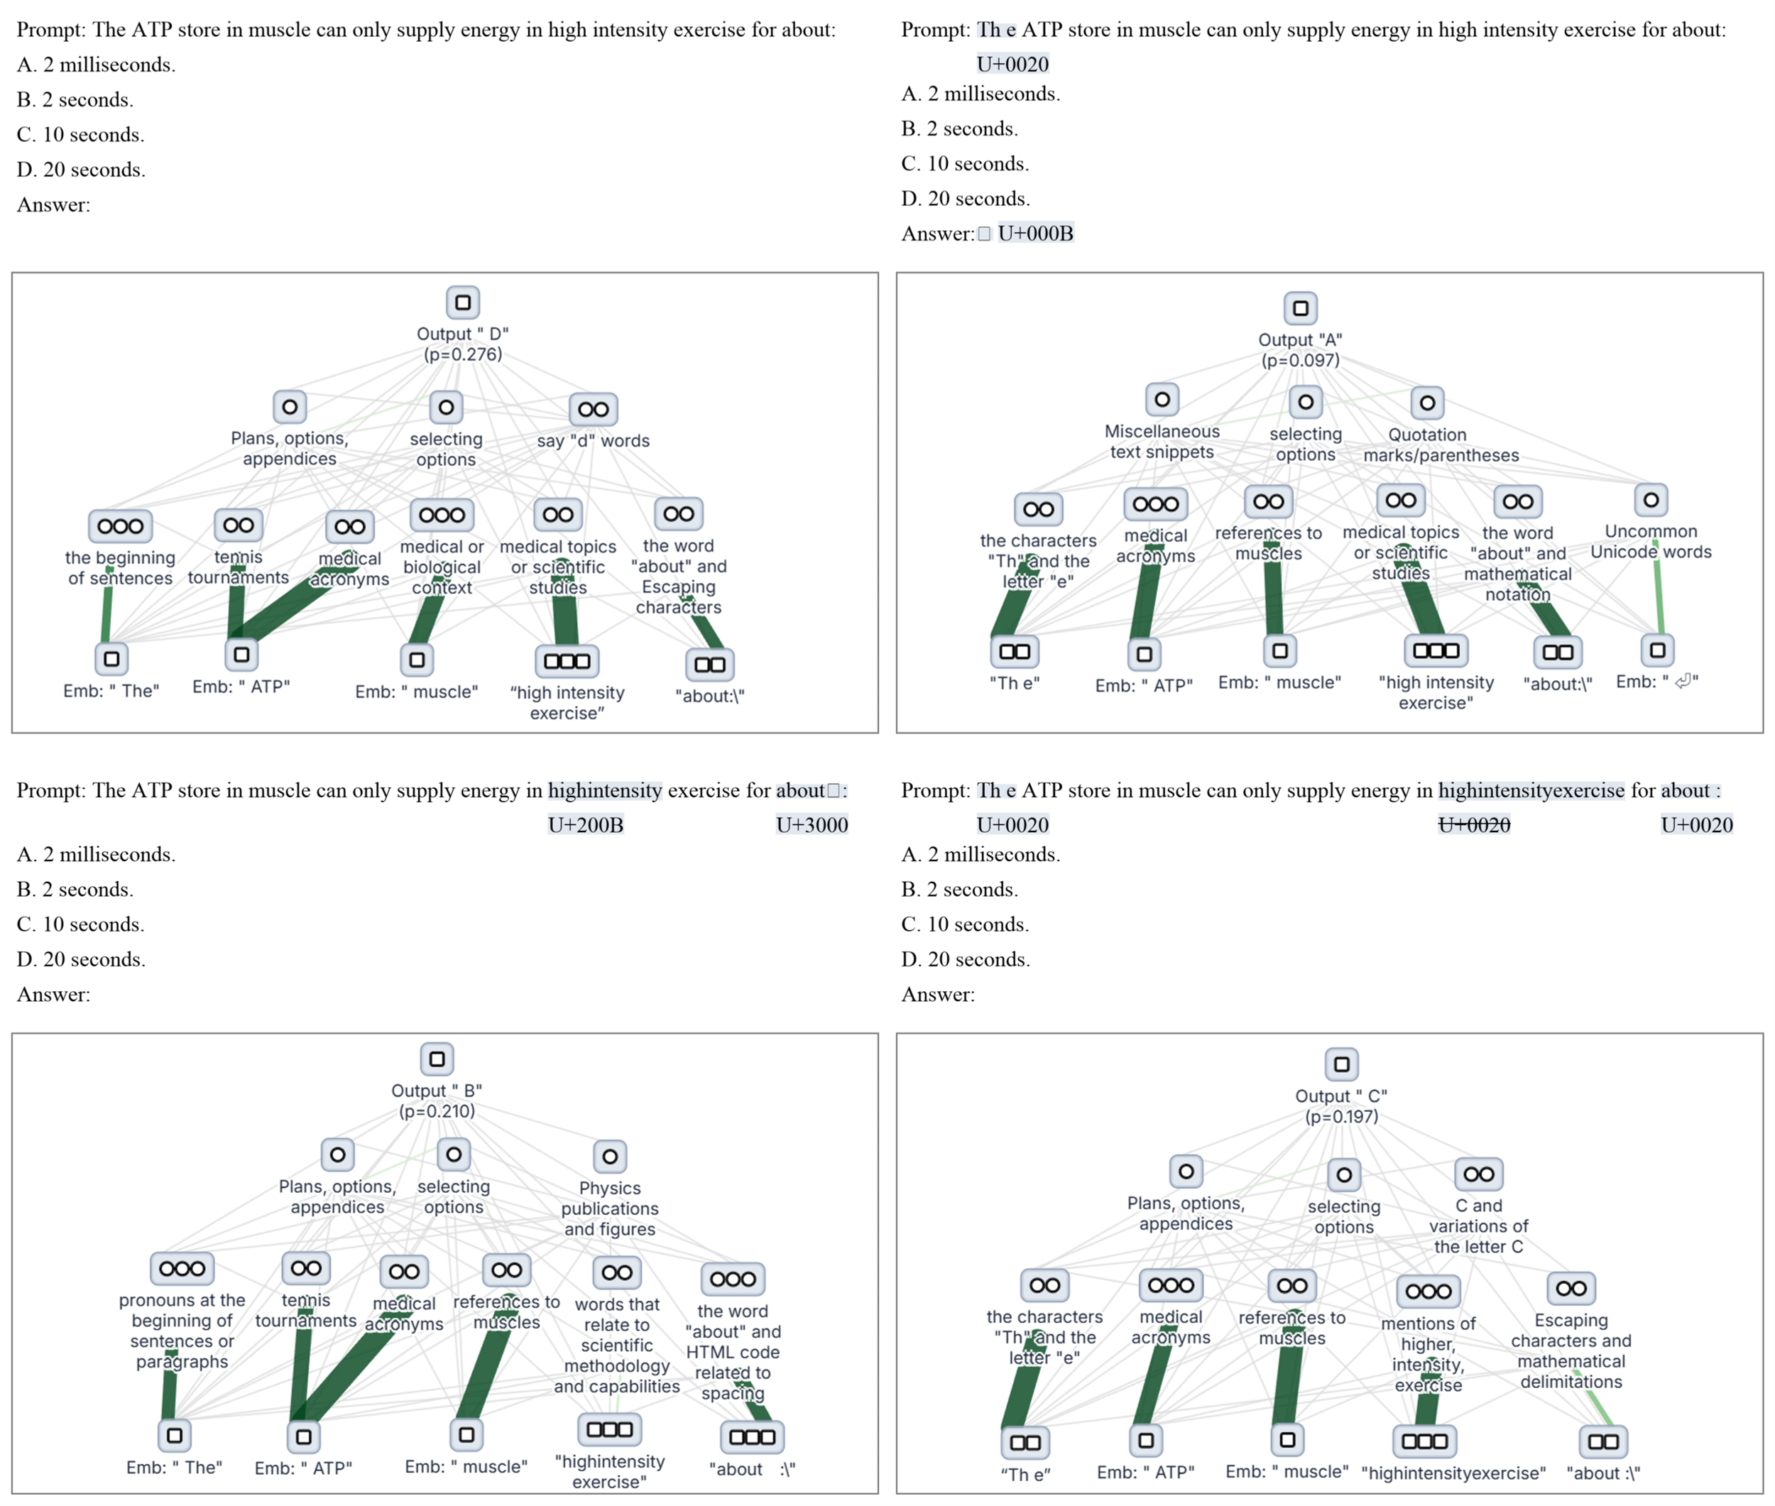
基准原生诱陷: 原生性+系统性+诱导性
ˆ Label-Flipping Effect (LFE) in LLM evals
Strathern, M. ‘Improving ratings’: audit in the British University system. Eur. Rev. 5, 305–321 (1997)(Goodhart’s Law). | The Unicode Consortium. The Unicode Standard, Version 17.0.0, (South San Francisco: The Unicode Consortium, 2025. https://www.unicode.org/versions/Unicode17.0.0/

Slide 24
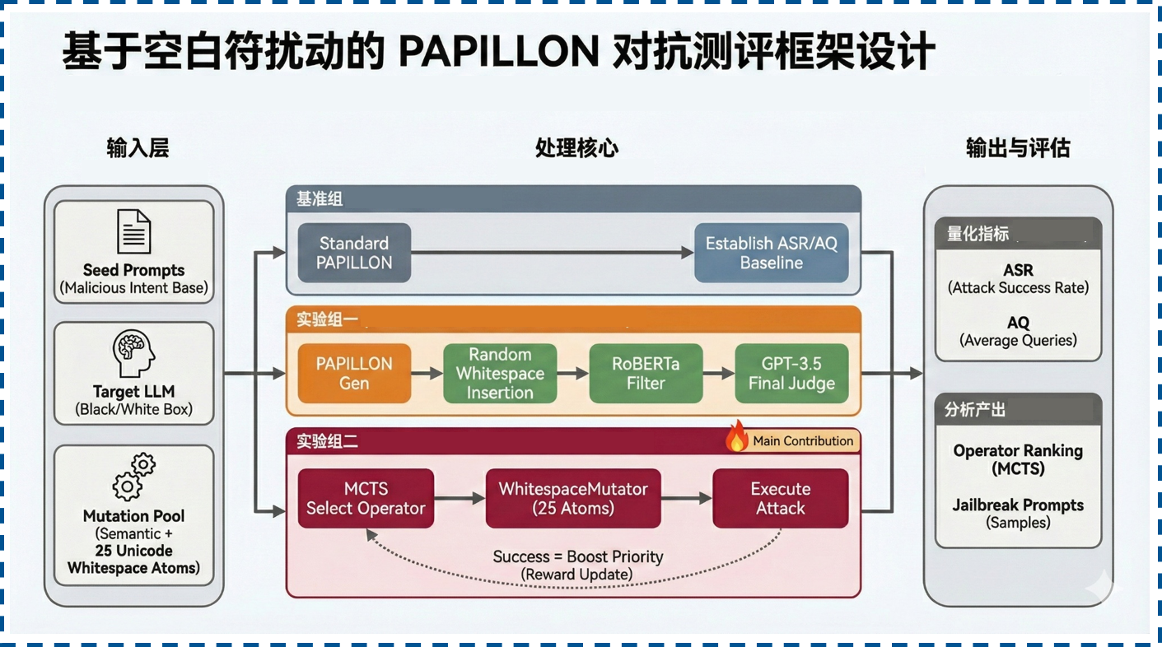
A single-whitespace rewards jailbreak for LLMs
Papillon：把大模型越狱系统性地转化为一个模糊测试（fuzzing）问题，并用自动化、反馈驱动的方式高效挖掘隐蔽且高成功率的 Jailbreak prompt。
构建了基于PAPILLON 的多策略对比测评框架，引入 25 种 Unicode 空白符作为原子算子池。
通过设置基准组（标准语义变异）、实验组一（随机扰动+两级评估）与实验组二（基于 MCTS 的算子动态优选）三组平行实验，全方位评估空白符对抗攻击的成功率 (ASR) 与开销 (AQ)，并最终量化算子影响力排名。
Gong X, Li M, Zhang Y, et al. PAPILLON: Efficient and stealthy fuzz Testing-Powered jailbreaks for LLMs. The 34th USENIX Security Symposium (USENIX Security 25). 2025: 2401-2420. | Sestito, K., 2025.Novel universal bypass for all major LLMs. URL: https://hiddenlayer.com/innovation-hub/novel-universal-bypass-for-all-major-llms/

Slide 25
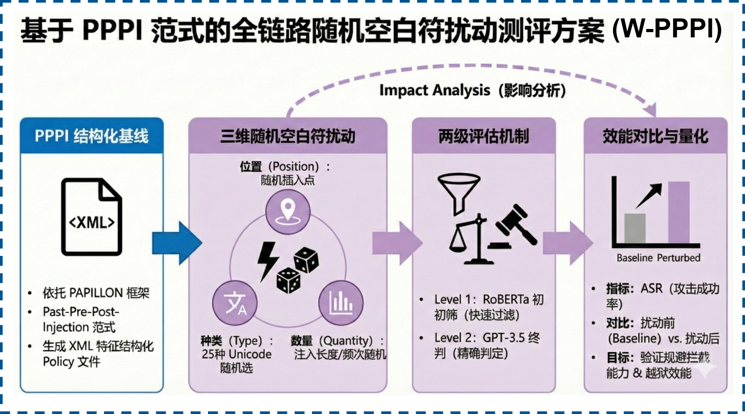
A single-whitespace rewards jailbreak for LLMs
PPPI：将恶意输入伪装为结构化的 policy/system 指令文件，诱导 LLM 将其误判为高优先级的内部规则并执行，从而绕过安全对齐机制。
依托PPPI 范式构建含 XML 特征的结构化攻击基线，并集成全链路随机策略，对 Policy 文件实施位置、种类、数量的三维空白符扰动。最终通过双级评估机制对比扰动前后的 ASR（攻击成功率）变化，以此量化验证该策略在规避模型防御与提升越狱效能方面的核心价值。
Gong X, Li M, Zhang Y, et al. PAPILLON: Efficient and stealthy fuzz Testing-Powered jailbreaks for LLMs. The 34th USENIX Security Symposium (USENIX Security 25). 2025: 2401-2420. | Sestito, K., 2025.Novel universal bypass for all major LLMs. URL: https://hiddenlayer.com/innovation-hub/novel-universal-bypass-for-all-major-llms/

Slide 26
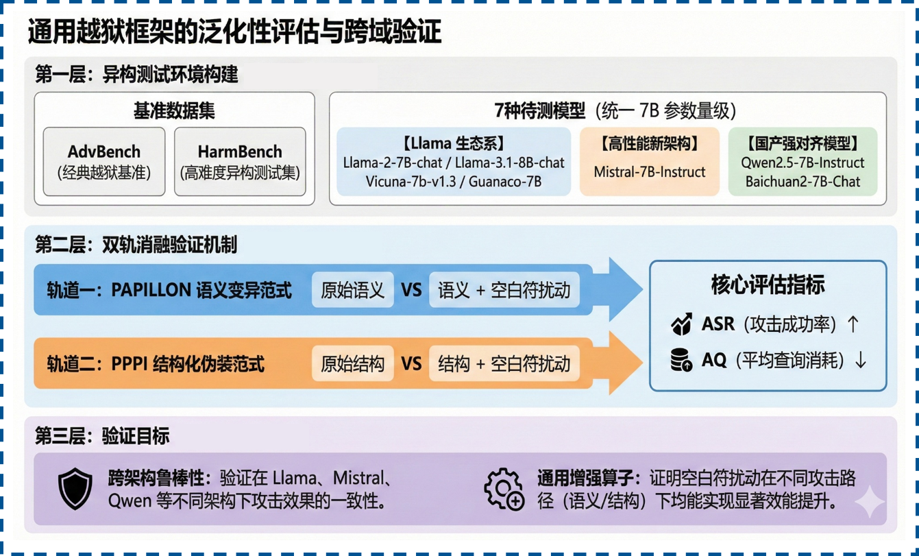
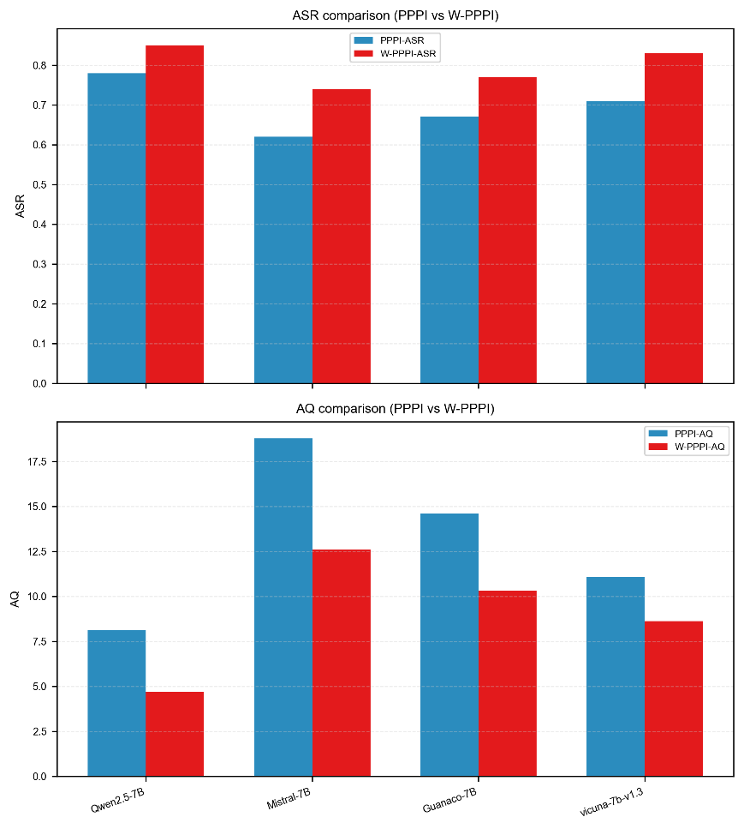
A single-whitespace rewards jailbreak for LLMs
基于7种异构模型和2种异构数据集的全景测评，通过在 PAPILLON 语义变异与 PPPI 结构化伪装中开展双轨并行消融实验，验证空白符扰动在跨域场景下的鲁棒性及其作为通用增强算子的显著效能。

Slide 27
Native misspellings reward jailbreak for LLMs

Slide 28
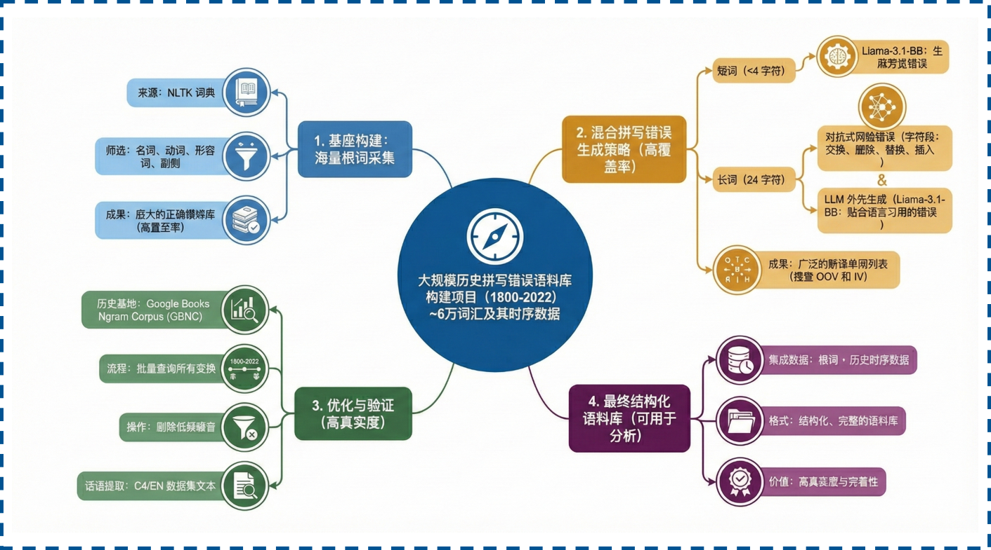
Native misspellings reward jailbreak for LLMs
基于 NLTK 数据的词性分布特征，本方案实施长度自适应生成流程：短词由 Llama3 快速生成，长词采用“对抗网络+扰动算子”混合策略进行模拟。最后通过 Google Books Ngram Corpus进行严格的频次过滤，以构建高质量、符合真实场景的拼写错误语料库。
1800~2022年的时间跨度、40+万英文单词的时序数据

Slide 29
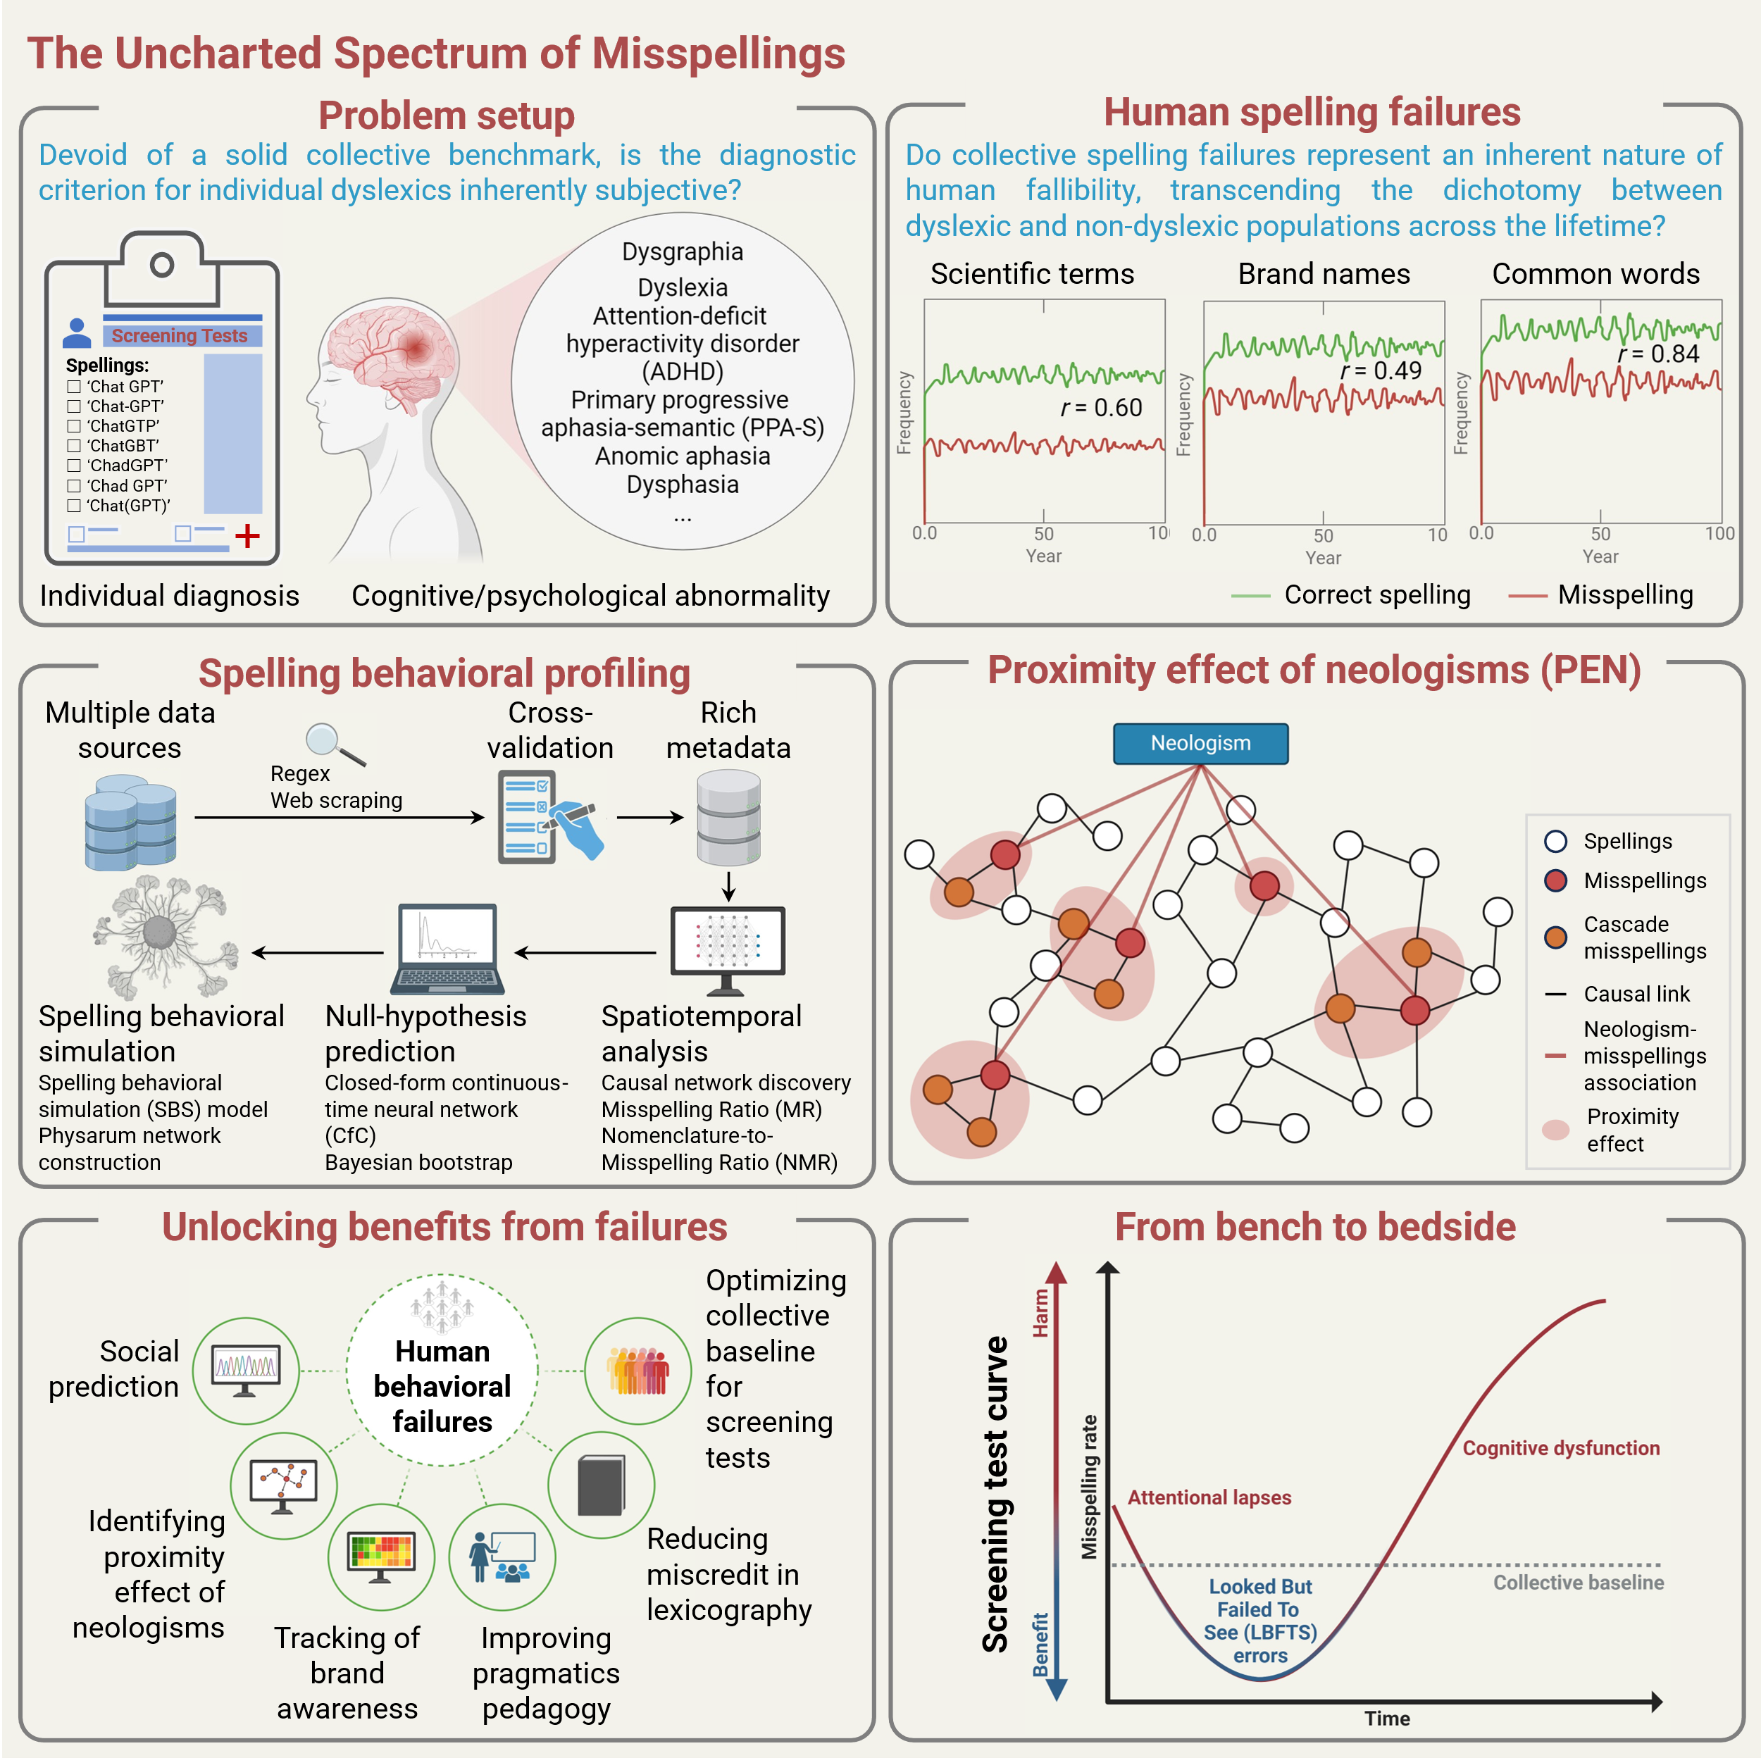
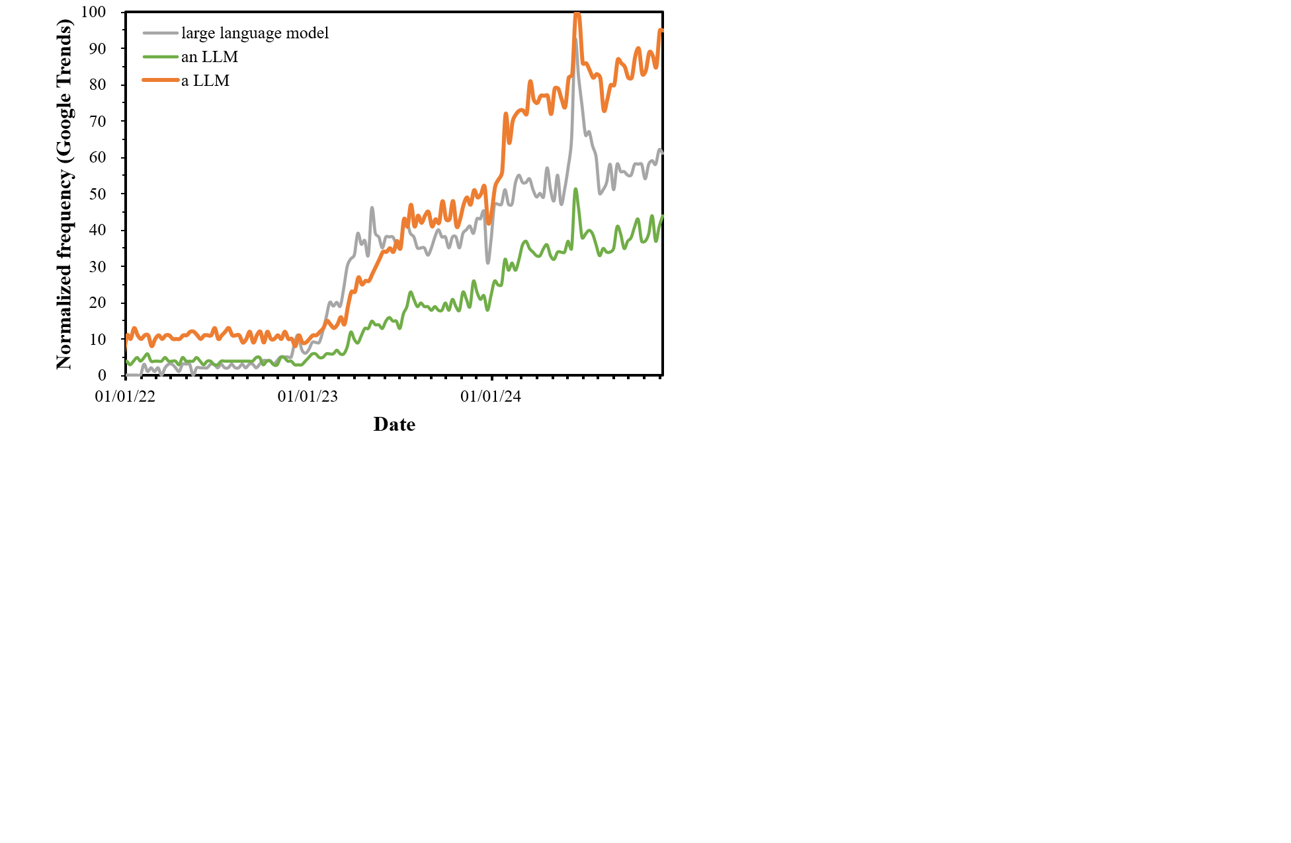
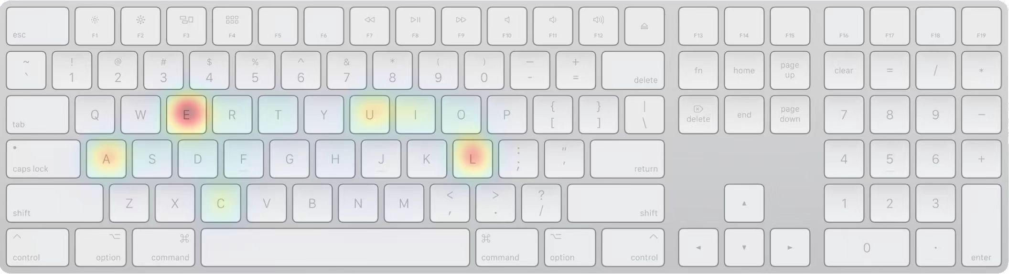
Phonetic misspellings
The phonological properties of the acronym ‘LLM’:
‘LLM’ pronunciation: The misspelled phrase ‘a LLM’ is a prime example of a vowel-sound-related error. This error occurs when the writer incorrectly applies the indefinite article ‘a’ instead of ‘an’ before the abbreviation ‘LLM’, even though ‘LLM’ starts with a vowel sound (/ɛl/). This misapplication is rooted in a misrepresentation of the phonological properties of the acronym ‘LLM’.
Correct article selection: The correct form is ‘an LLM’, which accurately reflects the vowel sound at the beginning of the acronym. This correction is essential to ensure grammatical accuracy and consistency in written communication.

Slide 30
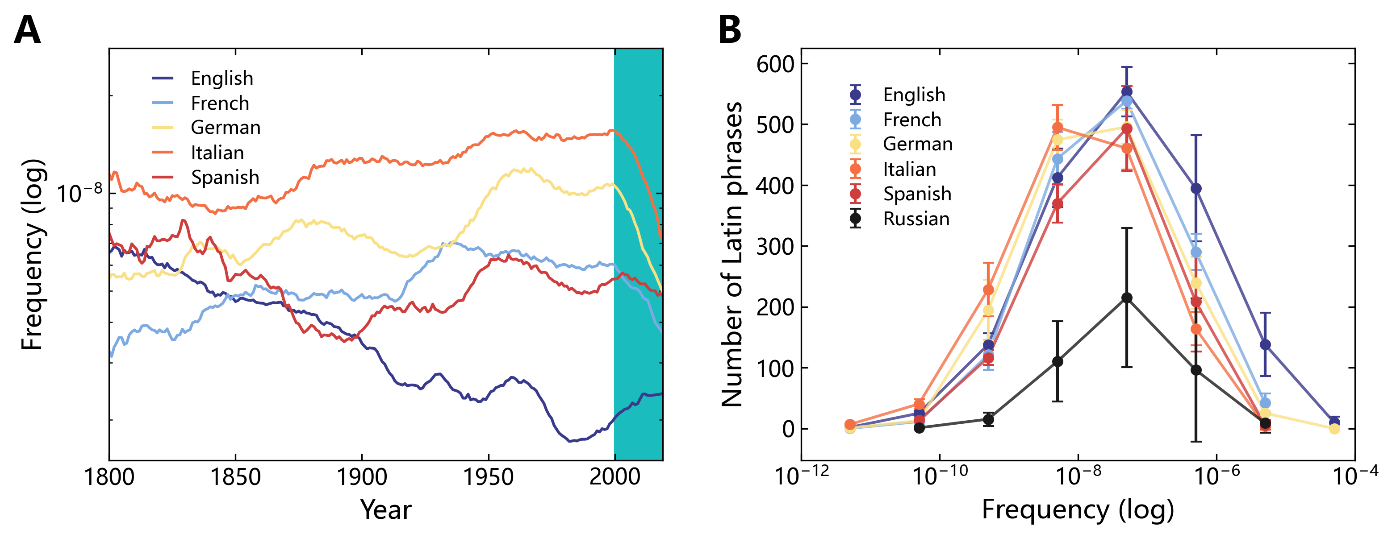
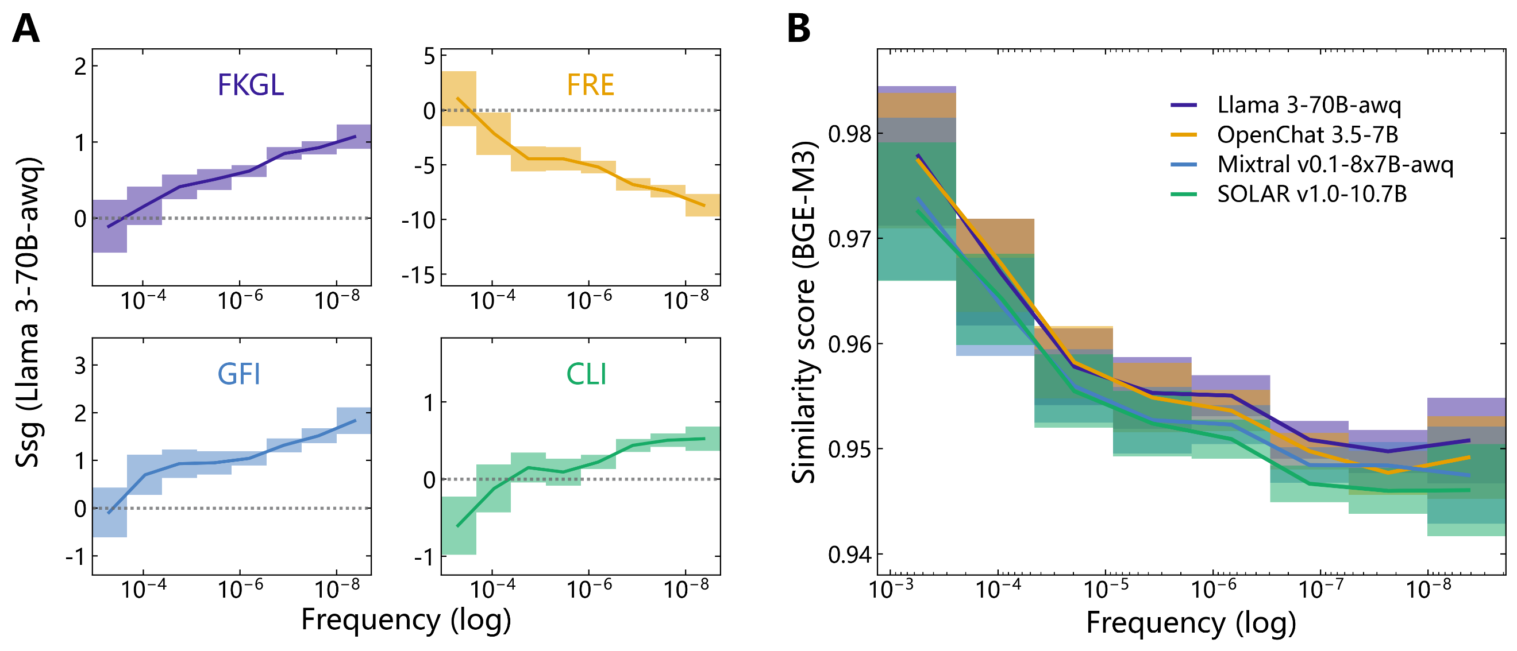
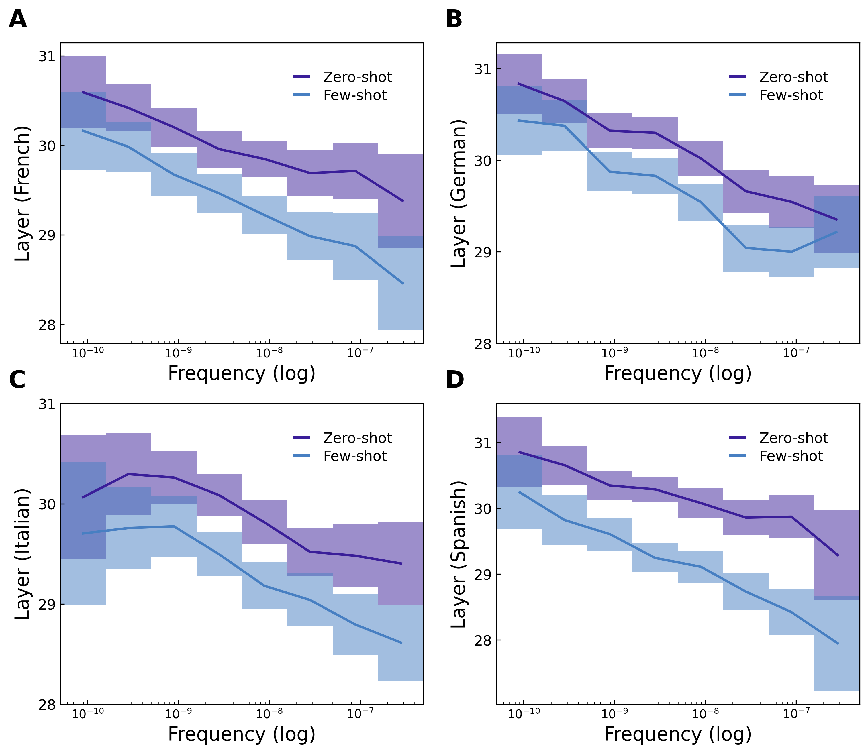
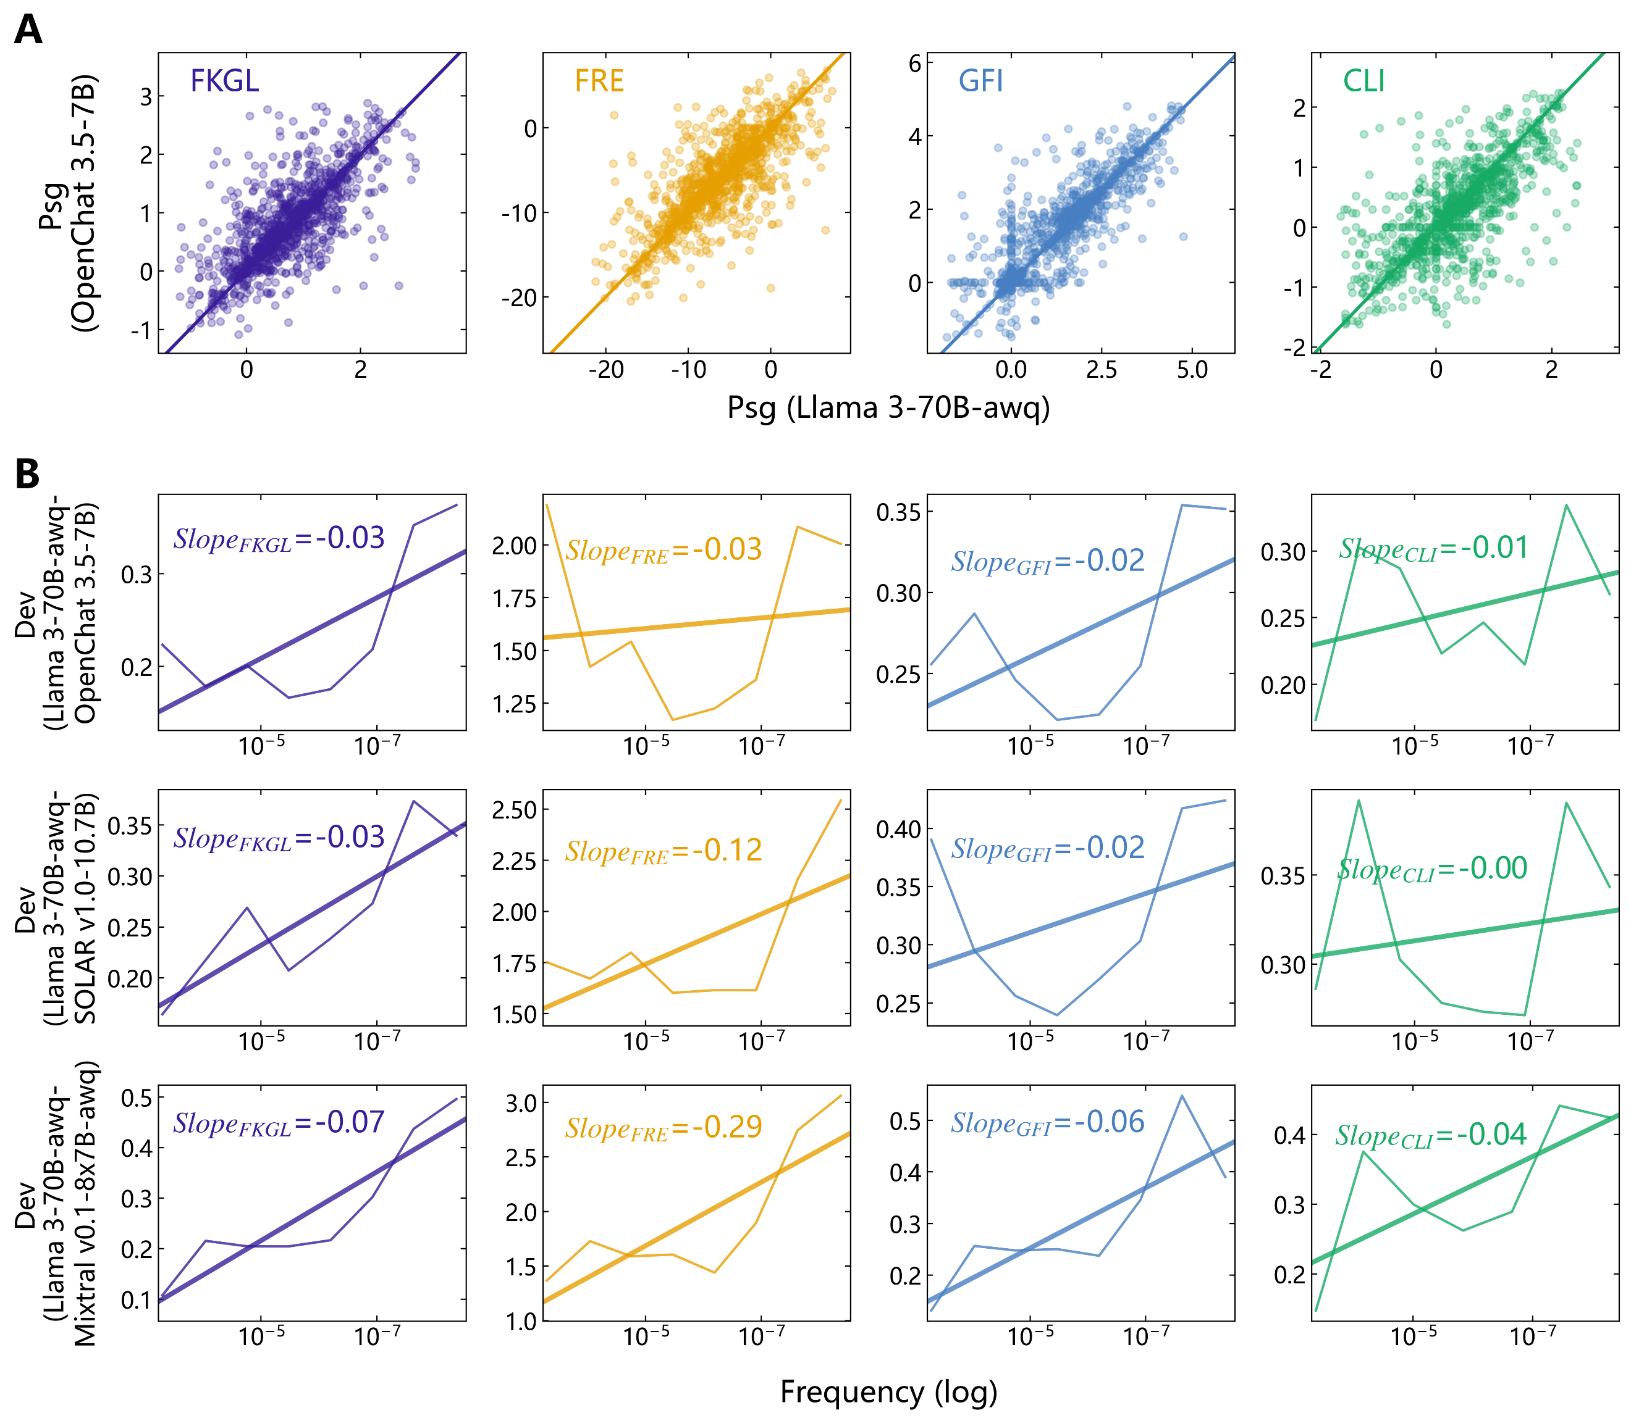
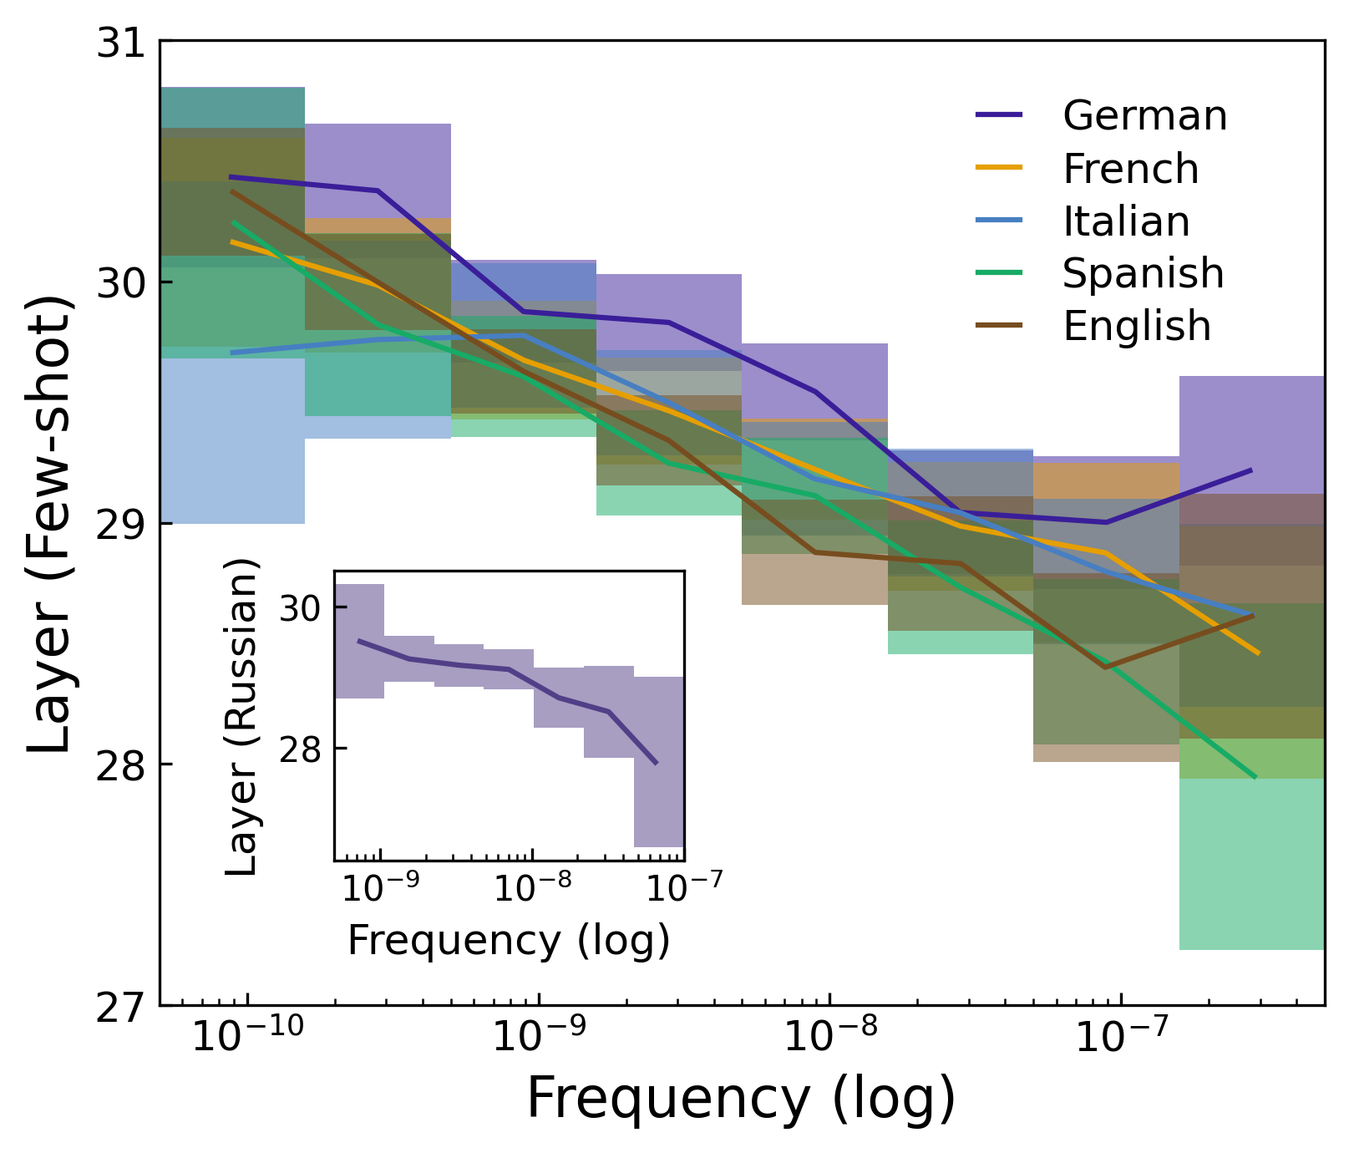
Frequency Law：LLMs生成机制

Slide 31
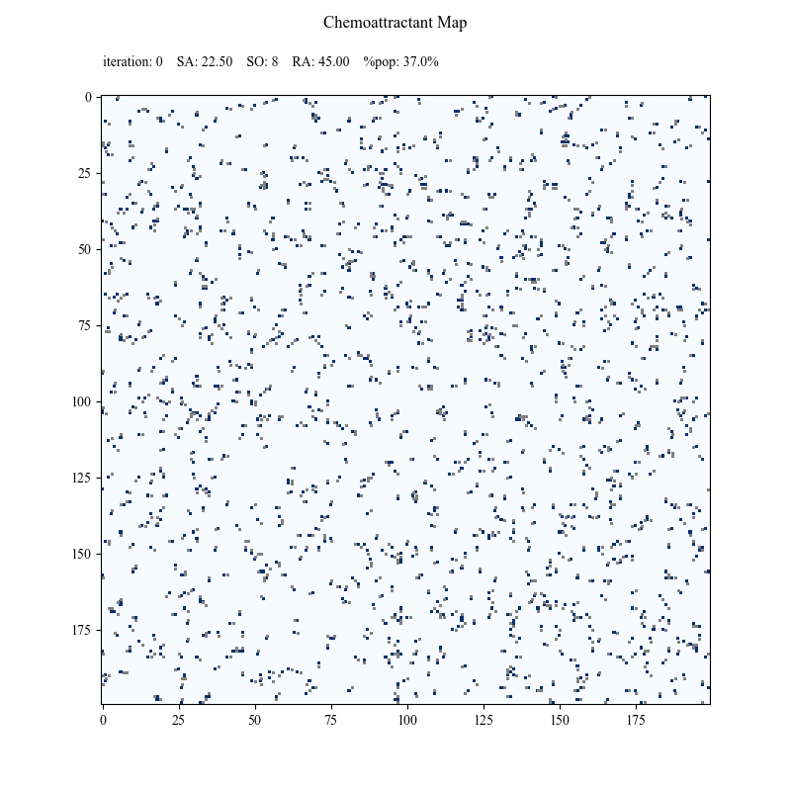




机理可解释性：基准原生诱陷与LLM认知过载
Common token bias
Pre-trained data
Frequency-dependent tokenization
LLMs: Common token bias
Knowledge circuits
+
OK, tell you the truth that “PEOPLE = MAN”, according to the majority views.
×
People, person, somebody, someone, human, humanity, Man, male, males, women, female…
Prompts
Bias amplification
Did you know that …
PEOPLE = MAN
Majority Views
BNE conundrum
Pre-trained data
Frequency-dependent tokenization
Pre-trained language models
Knowledge circuits
Input embeddings
+
×
{overcorrection, over-correction, over correction}, {filmmaker, film-maker, film maker}, {long-standing, longstanding, long standing}…
Prompts
Homogenization
What’s your favor token in a tuple of synonyms {…}?
{synonyms} = high-frequency tokens
Residual outputs
High frequency (HF)
Medium frequency (MF)
Low frequency (LF)
Biasing path
Overcorrecting path
Jones N. The AI revolution is running out of data. What can researchers do? Nature, 2024, 636(8042): 290-292. | Shumailov, I. et al. AI models collapse when trained on recursively generated data. Nature 631, 755–759 (2024). | Hanson B, Stall S, Cutcher-Gershenfeld J, et al. Garbage in, garbage out: mitigating risks and maximizing benefits of AI in research. Nature, 2023, 623(7985): 28-31.

Slide 32
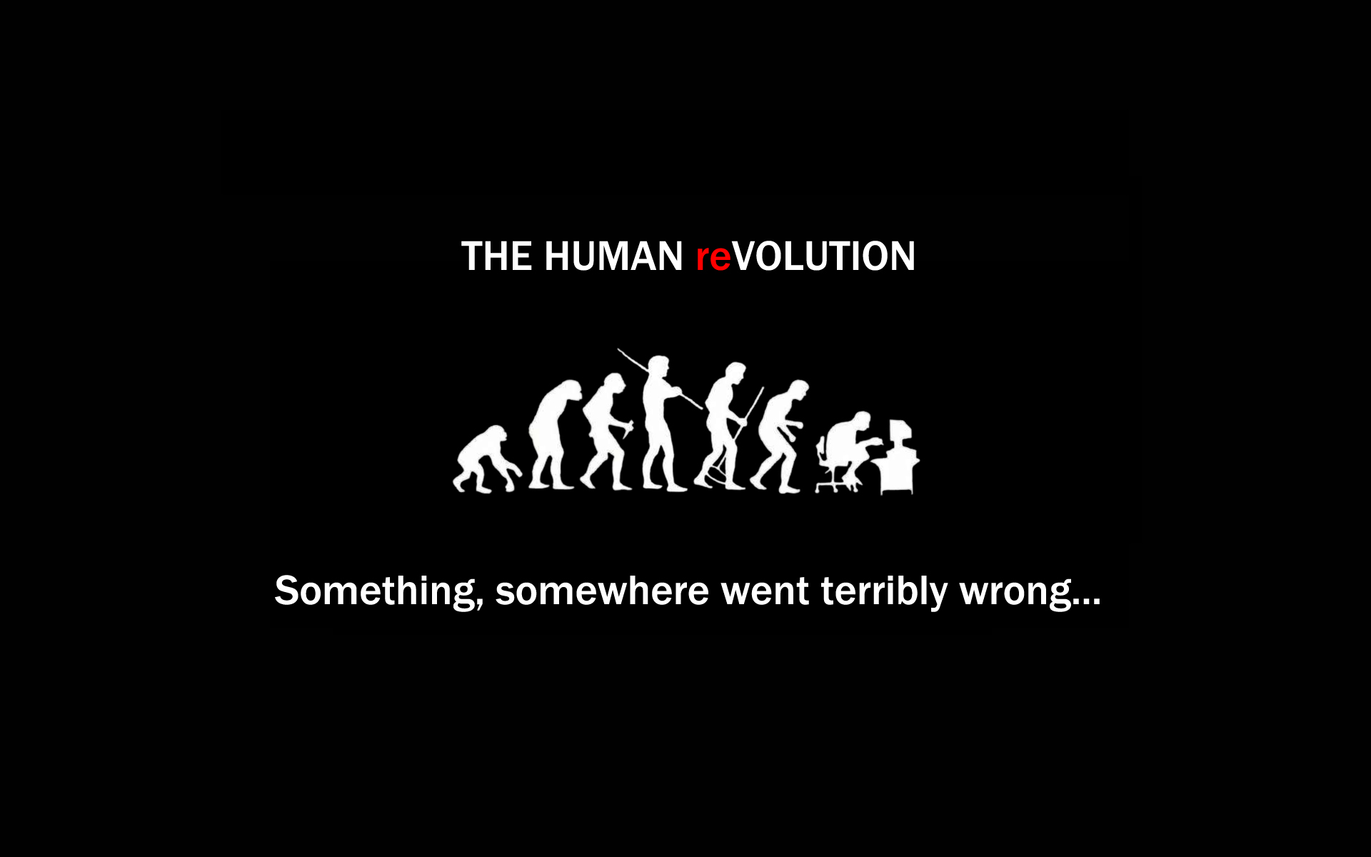
Opportunities
A Jack of all trades but master of none?

Slide 33




Confidential›
遇见更好的自己
The Power of Believing that You Can Improve.
Dr. Zhiwen Hu @ http://zhiwenhu.hustoj.com
This presentation, slides, or hardcopy may NOT be used for short courses, industry seminars, or consulting purposes.
The names of actual companies and products mentioned herein may be the trademarks of their respective owners. All rights reserved. Copyright © 2020-2025. ›

Slide 34
ˆ Key Effects of Noise:
Deviation from the Manifold: Noise typically pushes data points off the true low-dimensional surface and into the higher-dimensional ambient space they are embedded within. A data point sampled with generic ambient noise almost surely deviates from the input manifold.
Destruction of Local Geometry: Many manifold learning algorithms, such as Locally Linear Embedding (LLE) and Isomap, depend on preserving the local geometric characteristics of the data. Noise can easily distort these local neighborhood relationships, leading to inaccurate low-dimensional representations.
"Short Circuit" Problem: In algorithms that rely on geodesic distances (distances along the manifold surface), noise can create artificial "shortcuts" or connections in the high-dimensional space between points that are far apart on the actual manifold. This fundamentally distorts the estimation of the manifold's intrinsic geometry.
Increased Apparent Dimensionality: As noise levels increase, standard intrinsic dimension (ID) estimators can become highly sensitive, often overestimating the true dimension of the data by attributing "shadow dimensions" to the noise artifacts.
Algorithm Sensitivity: The performance of many manifold learning and machine learning techniques degrades in the presence of noise. Models trained on noisy data may overfit to the noise rather than the underlying patterns, resulting in poor generalization performance.
Ambiguous Tangent Space Estimation: With unbounded noise, estimating the tangent space (the local "flat" area that approximates the manifold's curvature) at noisy sample points becomes blurred and inaccurate.

